Slide 1
National Water Reuse Action Plan: Action 2.4.2

Slide 2
Why invest in Produced Water Reuse?
There is a lot of it. NM is the third largest oil producing state with over 52 billion gallons of produced water generated in 2019 alone.
Most is not reused. Federal regulations allow for beneficial reuse of produced water west of the 98th Meridian; however, current estimates of produced water disposition in NM:
60% disposed in deep injection wells
30% used in enhanced oil recovery
10% recycled in oil drilling
Climate change is making our arid State even dryer. For a portion of 2018, over 90% of the State was in moderate, severe, extreme or exceptional drought.
Innovations and advancements in treatment options are rapidly increasing.
Legislative action. Produced Water Act (2019) explicitly requires that any use of produced water outside the oil and gas industry be regulated by NMED.
Environmental and public health mission. The level of treatment necessary to protect human health and the environment depends upon the intended use, available treatment technology, analytic methods, etc.

Slide 3
NM-Produced Water Research Consortium
In September 2019, the New Mexico Environment Department and New Mexico State University entered into a Memorandum of Understanding to fill science and technical gaps related to the treatment and reuse of produced water for purposes outside of oil and gas.
Pursuant to the MOU, NMSU has created the New Mexico Produced Water Research Consortium (NM-PWRC).
Public and private funding to carry out produced water research
Comprised of academia, the private sector, state and federal agencies, and non-governmental organizations
Not a regulatory or policy-making body
Science will guide NMED’s future regulatory decision-making regarding produced water treatment.
Protect public health and the environment
Reduce reliance on increasingly limited fresh water supplies

Slide 4
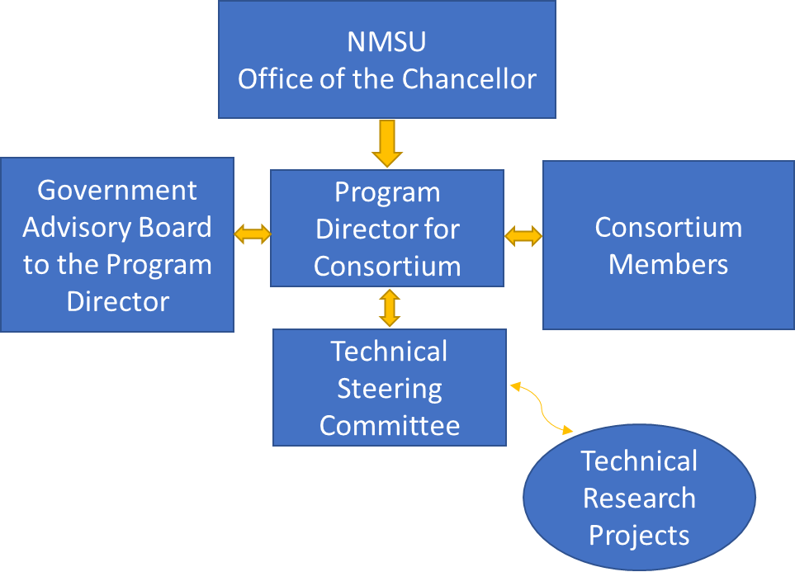
NM-Produced Water Research Consortium
The structure of the NM-PWRC builds on a recognized model developed by the National Science Foundation to promote the progress of science to advance national health, prosperity, and welfare.

Slide 5
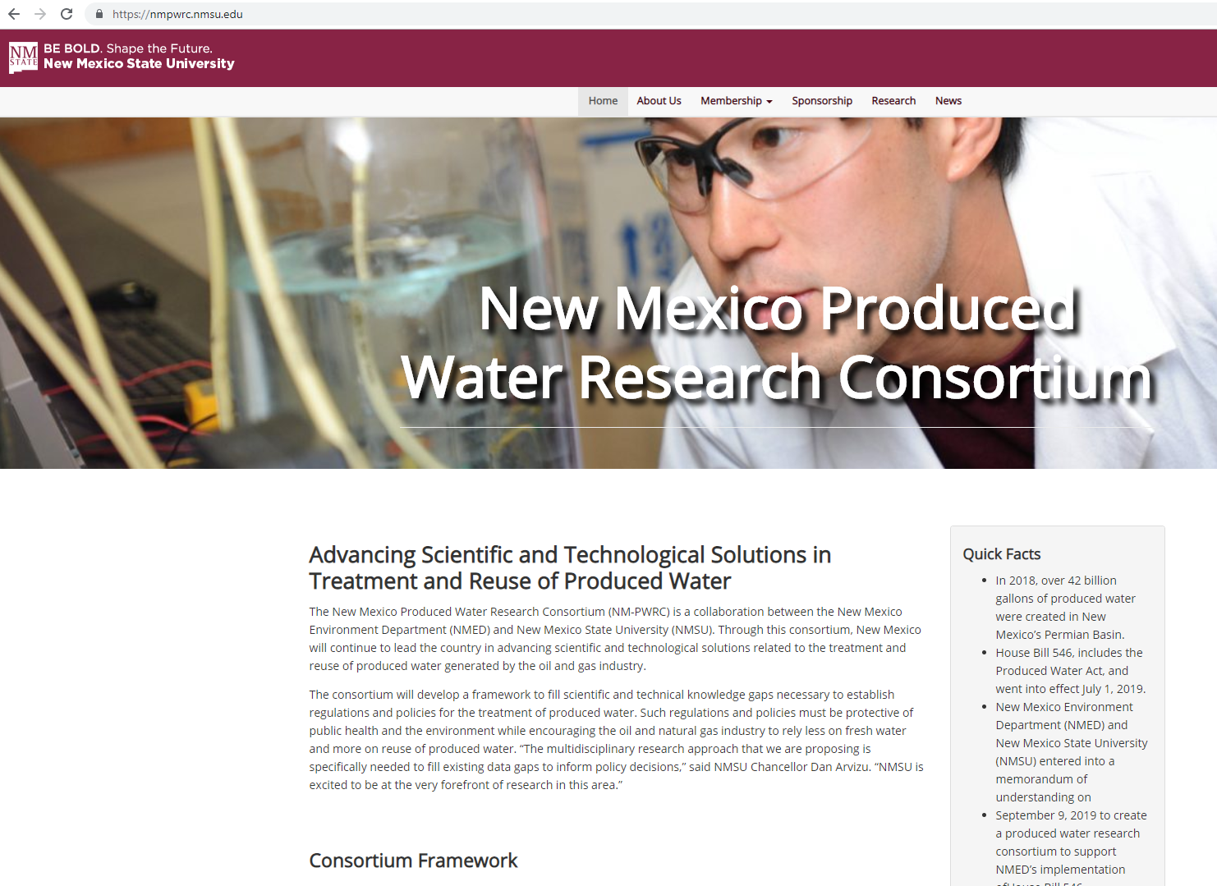
NM-Produced Water Research Consortium
Details available at https://nmpwrc.nmsu.edu/.

