Slide 1
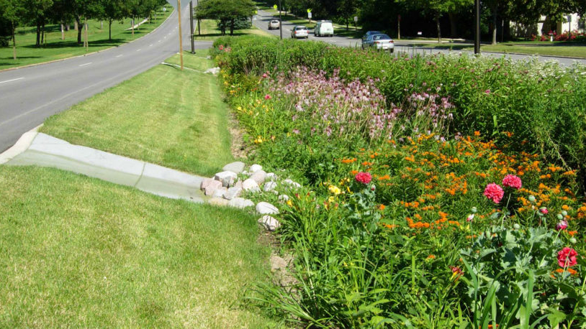
Using Section 319 to Address Urban Runoff
  Lynda Hall, Chief
  Nonpoint Source Management Branch, USEPA
Notes:
Greendale, WI bioswale
https://www.flickr.com/photos/87297882@N03/albums/72157631557895552

Slide 2
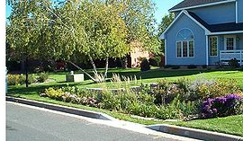
What We Will Cover
Clean Water Act §319 support for and role in urban projects
Other opportunities for funding urban runoff/GI/LID projects
Assessing eligibility for §319 funding
Urban project Success Stories
Notes:
Burnsville Raingardens – Minnesota ( 319 funded)

Slide 3
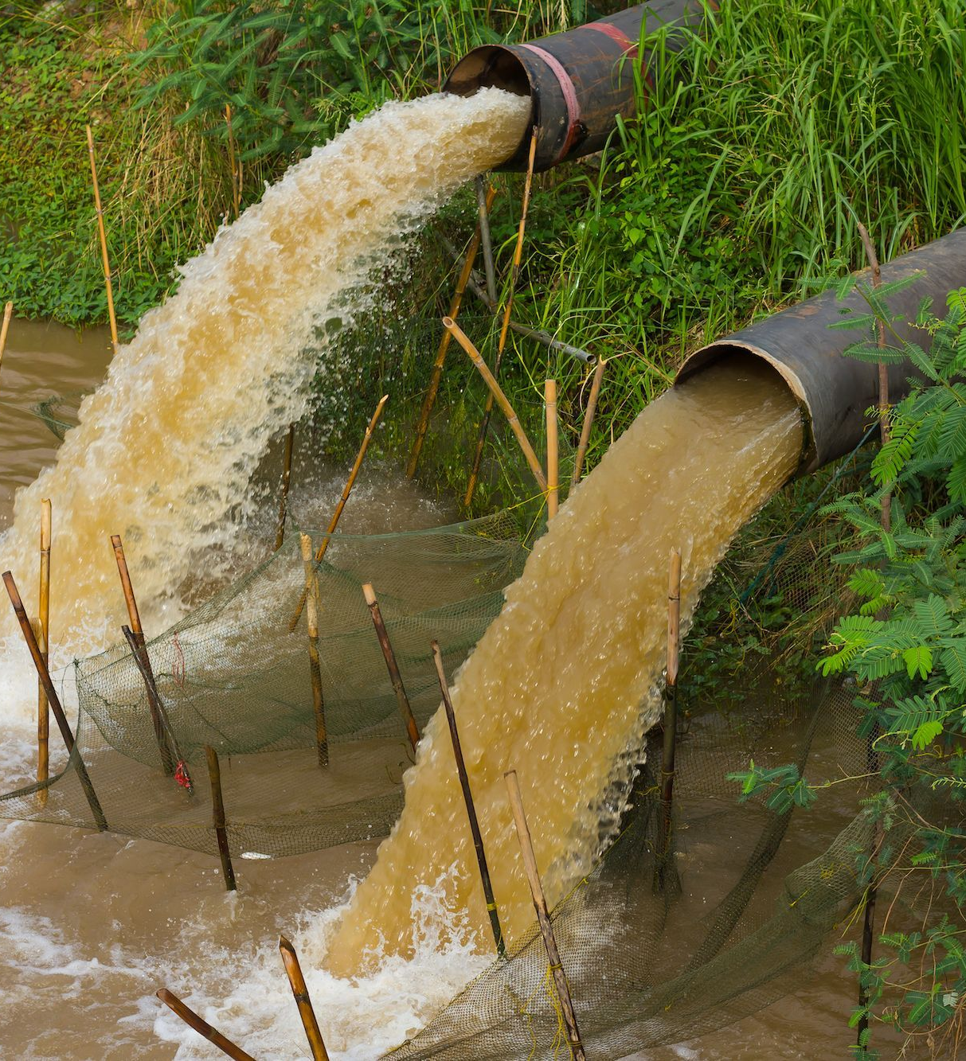
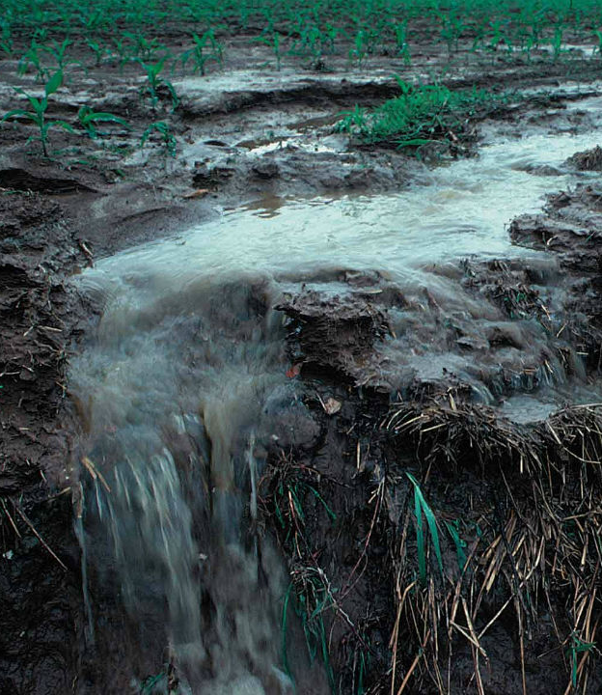
Definitions under the Clean Water Act
‘Point sources’ regulated under CWA
Any “discernable, confined and discrete conveyance including…any pipe, ditch, channel…[etc] from which pollutants are or may be discharged”
Discharges must be regulated in a manner consistent with state/tribal WQS, e.g., NDPDES permits
‘Nonpoint sources’ not regulated or specifically defined
  Any source of water pollution that doesn’t meet point source definition
  Polluted runoff from rain or snowmelt carrying natural and anthropogenic pollutants to waters
  Includes: agriculture stormwater discharge and irrigation return flows
https://www.nationalgeographic.org/encyclopedia/point-source-and-nonpoint-sources-pollution/
https://adventuresportsjournal.com/nonpoint-source-pollution/

Slide 4
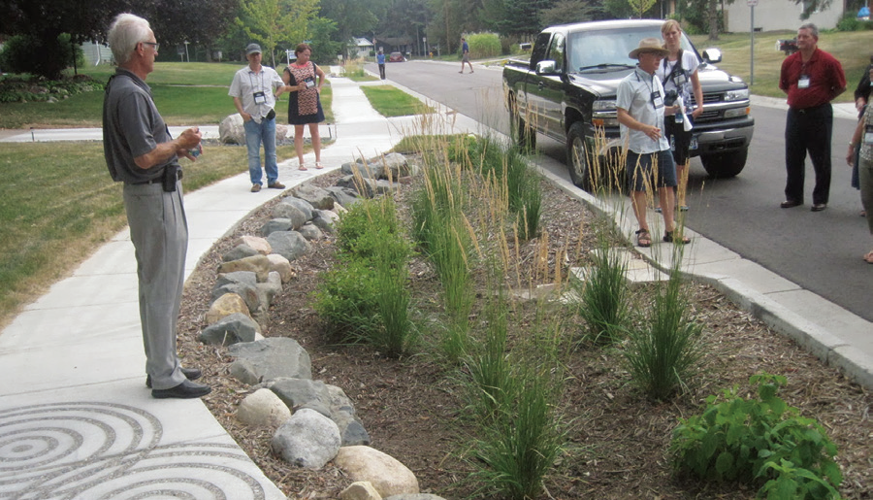
The Importance of NPS Work in Urban Areas
An array of valuable NPS projects are funded by §319 in urban areas
These can be complemented by other funding sources that may better fit any given project
Notes:
Photo St. Paul Minnesota
There are many great potential projects that can be implemented in urban settings. As a starting point for our discussion, let’s assume that the proposed work has been deemed technically sounds and appropriate for the location.
That then brings us to the question of which funding mechanism is most appropriate. In some cases it might be 319 but there are other potential funding options to also consider.
Projects should be considered on a case-by-case basis to determine whether/how well 319 fits in the context of the proposed work.
So it's important to remember when we are saying a project may not be eligible we are not saying " good vs. Bad" its just determining the most appropriate federal funding vehicle.

Slide 5
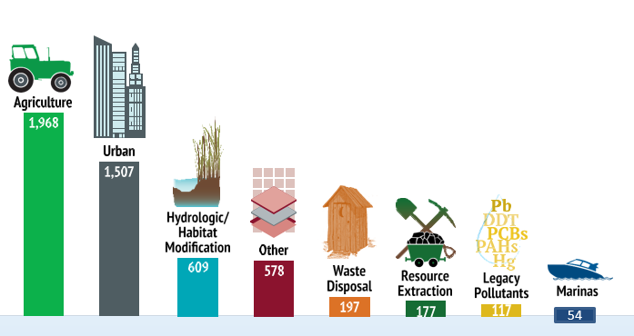
Section 319 Projects by Type 2008-2013
Notes:
Here is a national snapshot of the types of projects funded by 319 - as you can see urban and ag type projects tend to the most frequent types of projects.
MS4 is a legal definition NPS is determined by land use.

Slide 6
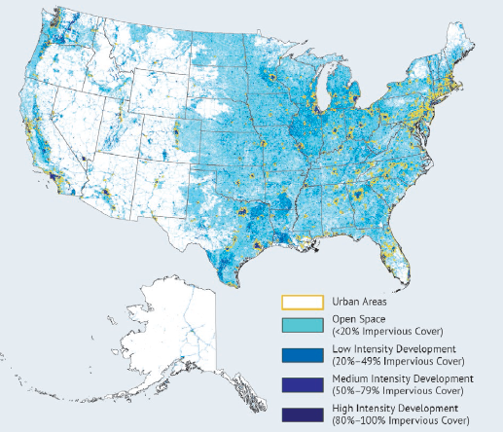
Land use (NLCD and Census)
Urban §319 Investment by Project Type (2008-2013)
(Shown as Outline)
Notes:
Here we have the urban (non-MS4) view of land use darker blue indicates higher level of impervious surface and the yellow outline indicates Urbanized centers based on 2010 US Census data
At a simple comparison you can see parallels from the land use to the concentration of 319 dollars dedicated to addressing urban NPS sources

Slide 7
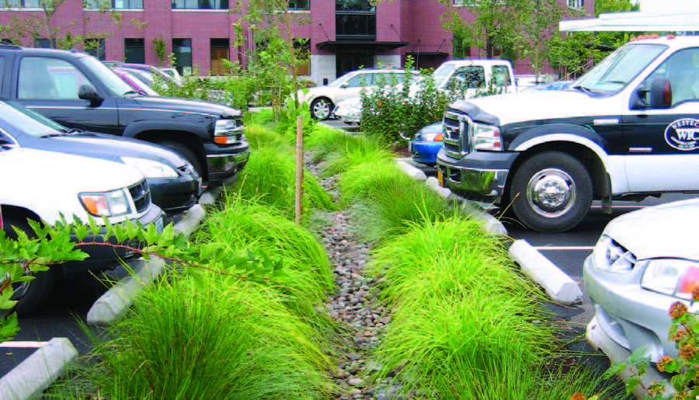
Funding Options for
Urban NPS Projects
Multiple funding sources can be leveraged with §319 funds in urban areas
State Revolving Fund (SRF)
Other infrastructure funding
FEMA – Hazard Mitigation
Notes:
Obviously we are focusing on 319 for this panel discussion but we want to make sure you all are aware of the (significantly larger) funding sources that also allow for funding nonpoint source work IF (emphasize) it is also in their Nonpoint source management plan. (give more details later when touch on each)

Slide 8
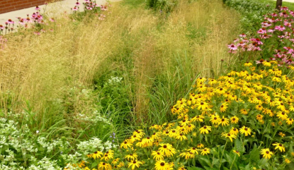
Potential Funding Sources
Clean Water SRF for Stormwater Management
  Range of project types
  Eligible groups include any public, private or non-profit entity that is addressing stormwater issues
FEMA Hazard Mitigation Grant Program
  GI/LID projects
  NPS projects may be eligible for FEMA funds when watershed and hazard mitigation plan goals align

Slide 9
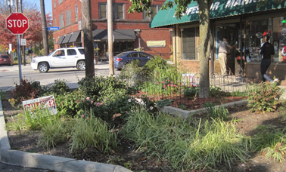
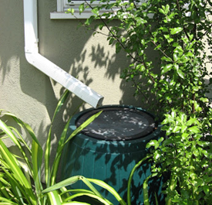
§319 Program Guidelines for Urban Stormwater Runoff
Generally Eligible Activities
  Green stormwater infrastructure activities
  Watershed Planning
  Technical assistance to state and local stormwater programs
  Monitoring needed to design and evaluate the effectiveness of implementation strategies
  BMPs for pollution prevention, runoff control (not permit-required)
  Outreach and education
  Technology transfer and training
  Development and implementation of regulations, policies, and local ordinances ( may apply to areas covered by NPDES permits, provided that the regulations, policies and ordinances apply to non-permitted areas as well.)
  Stormwater projects occurring outside of the NPDES permit area

Slide 10
§319 Program Guidelines for Urban Stormwater Runoff
Section VIII.B of §319 Program Guidelines provides framework for determining eligible uses of 319 funds in urban/MS4 areas:
“States may use § 319 funds for those urban stormwater activities that do not directly implement a final (municipal separate storm sewer system (MS4)) NPDES permit
... may support but do not directly implement activities required by Phase I or Phase II permits, as well as activities that go above and beyond permit requirements.
In addition, states may use § 319 funds for stormwater management activities that are not subject to NPDES permitting requirements under either §§ 402(p)(2) or 402(p)(6).”

Slide 11
Questions to Ask When Assessing Project Eligibility for §319 Funds
Is the proposed project/practice required by or credited to the NPDES permit or CWA federal directive? Does the project fund ‘gray’ infrastructure?
Is the project/practice distinguishable from actions being taken to comply with an NPDES permit or other federal directive?
If the proposed practice is similar to actions required by the NPDES permit, would the §319-funded practices go above and beyond permit requirements or otherwise not be used to meet permit requirements?

Slide 12
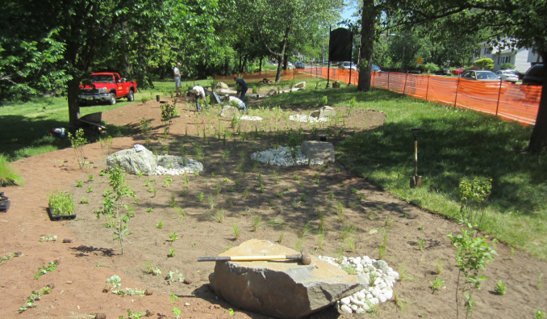
Urban Success Story: Rahway River, NJ
Problem
Dissolved oxygen impairment resulting from urban runoff
>80% urban land use in watershed
Story Highlights
Robinsons Branch Regional Stormwater Management Plan (watershed-based plan)
Green Infrastructure practices including Cisterns, Porous Pavement, and Raingardens/Bioretention Basins
Results
Observed Annual Loading Reductions: ~2 pounds (lbs) of total phosphorus, ~120 lbs of total suspended solids, and >950,000 gallons of stormwater runoff
Notes:
Green infrastructure projects were completed by Rutgers. NJDEP awarded Rutgers $512,000 in CWA section 319(h) grant funds beginning in 2010. Other project partners included Rahway City, Rahway River Watershed Association, Clark Township, and local landowners. Project partners’ significant volunteer efforts to engage local stakeholders, homeowners, and the general public played an important role in the implementation of the BMPs.

Slide 13
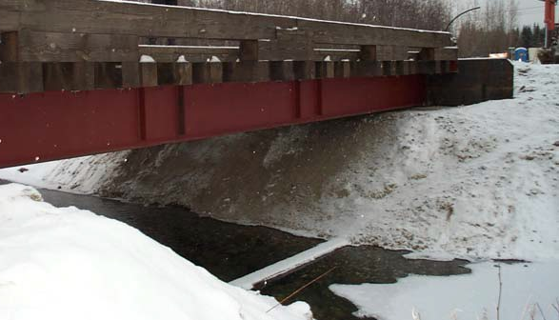
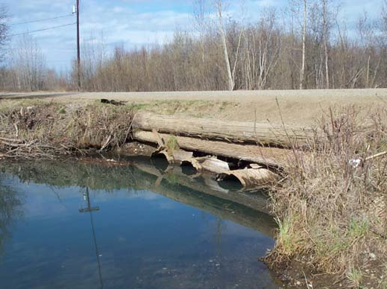
Urban Success Story: Chena River and Noyes Slough, AK
Problem
Sediment erosion and stormwater runoff from Fairbanks, AK
Story Highlights
BMPs (pre-MS4 permit) include: Debris removal, streambank stabilization, culvert replacement
BMPs (post MS4 permit) include: Outreach and education, green infrastructure practices that don’t implement permit requirements
Results
State WQS achieved and waterbody removed from 303(d) list in 2014
Before
After
Notes:
Partners and Funding:
Numerous partners have worked to improve water quality in the area, including UAF, COE, USFWS, ADF&G, ADEC, and local groups. Funding for the 2002–2009 culvert replacement project included a $75,000 National Fish and Wildlife Foundation grant and $374,000 in state grant monies ($374,000),. Beginning in 1999, Fairbanks used CWA section 319 funds to (1) map, inventory, and model Fairbank’s stormwater drainage system to allow better management (1999– 2004: $541,500), (2) prioritize potential sedimentation sources (2002: $60,414), and (3) assess water quality and BMP effectiveness (2004: $175,000)..

Slide 14
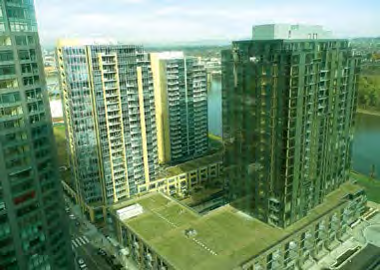
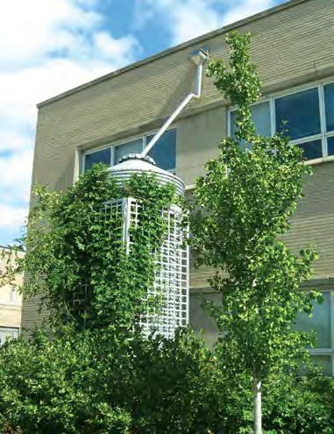
Thank You
Notes:
Photos from EPA LID Barrier Busters
Portland Oregon Green Roof
Chicago! Center for Neighborhood technology

