Slide 1
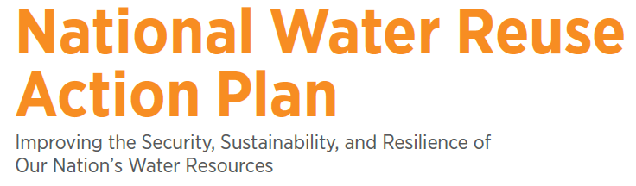
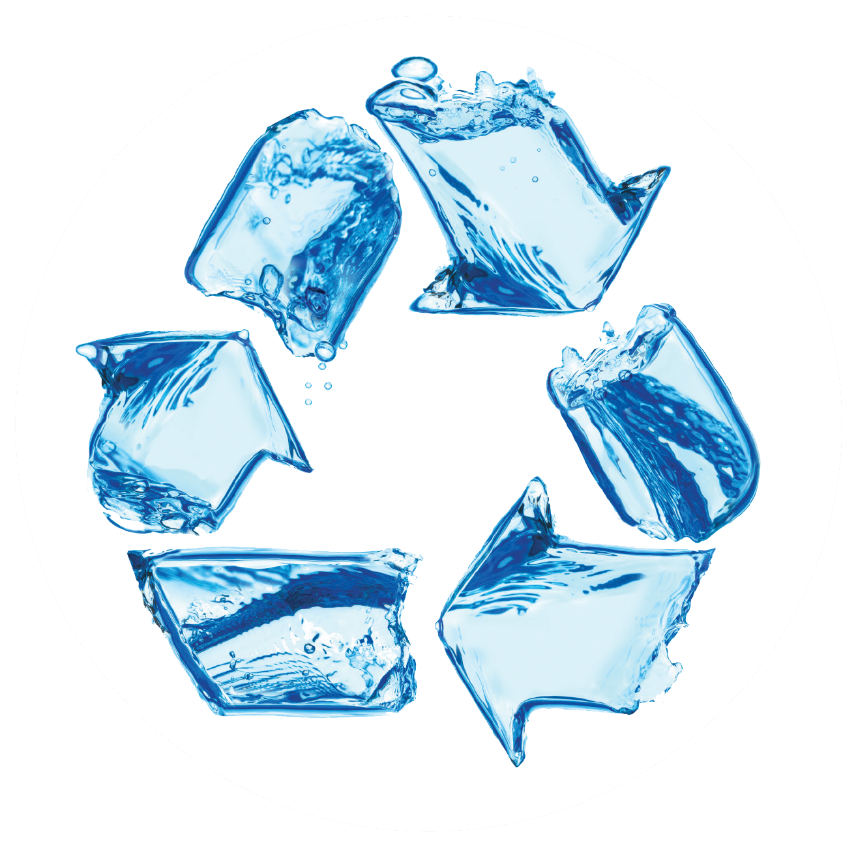
2020 ACWA Mid-Year Meeting
March 17, 2020
waterreuse@epa.gov

Slide 2
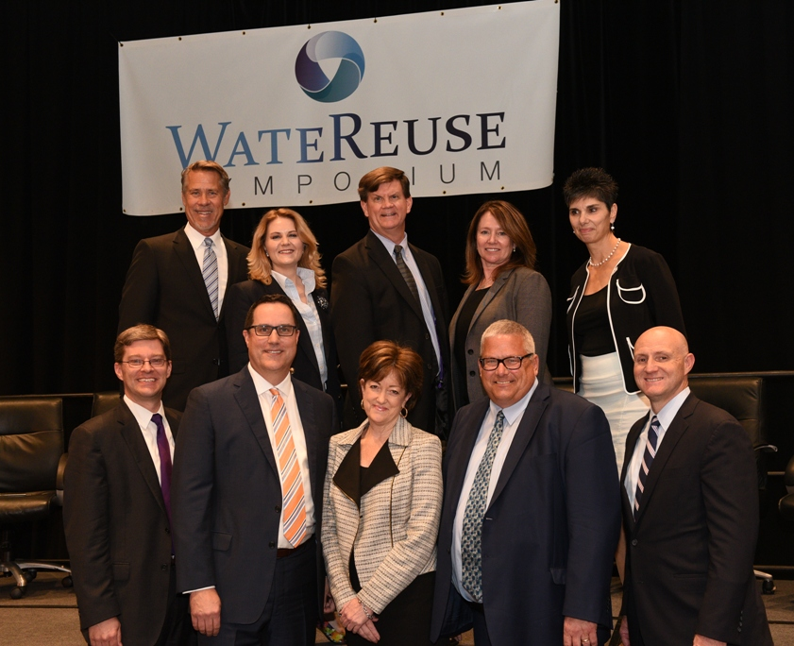
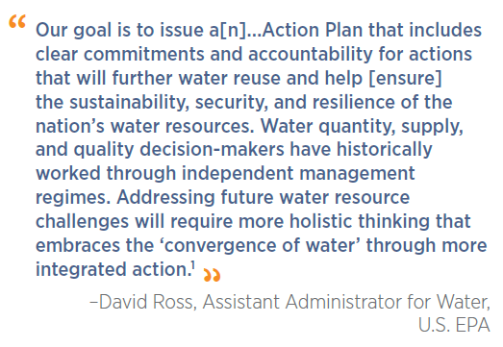
The Vision

Slide 3

Opportunities and Key Terms
Water Reuse Objectives:
Water security: The capacity of a population to safeguard sustainable access to adequate quantities of acceptable quality water for sustaining livelihoods, human well-being, and socioeconomic development.
Water sustainability: Ensuring an adequate, reliable, and continual supply of clean water for human uses and ecosystems.
Water resilience: The ability of a water supply (e.g., a community water system or an asset of a community water system) to adapt to or withstand the effects of rapid hydrologic change or a natural disaster.

Slide 4
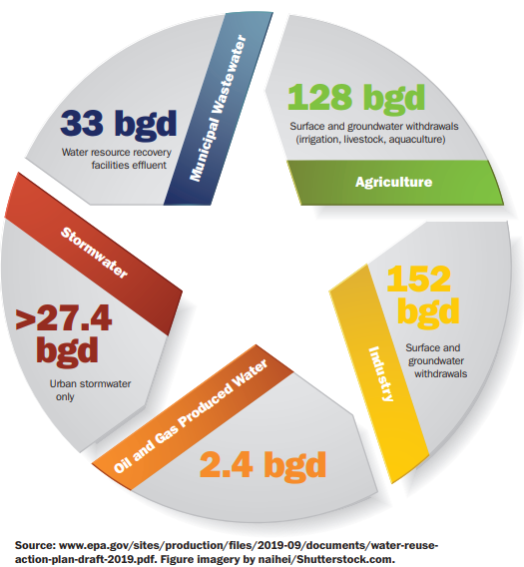
Sources of Waters and Potential for Reuse
Clear potential to reclaim more of the nation’s water
Nearly 350 BGD from various sources of water discharged
Over 280 BGD potentially available
for reuse
* Estimates from draft Action Plan, page 6
      Image source: https://awwa.onlinelibrary.wiley.com/doi/abs/10.1002/awwa.1426

Slide 5
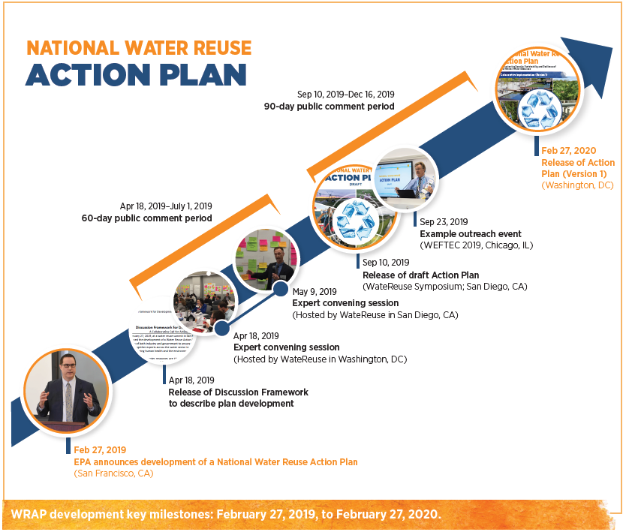
Building the WRAP: Timeline & Features
Key Features
Ongoing stakeholder outreach and communication
Weekly progress updates
Regular federal partner meetings
Adaptive management
Collaborative development and implementation

Slide 6
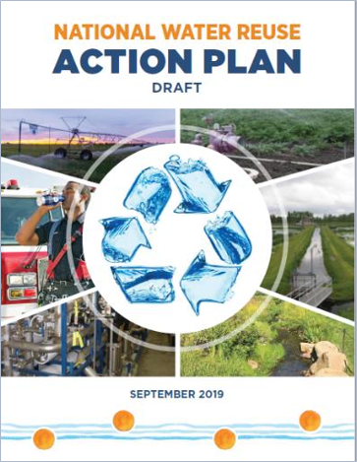
Draft Action Plan – September 2019
Content Overview:
Call to Action​
Section 1​
  The business case ​
Section 2​
  10 strategic objectives​
  46 proposed actions​
Section 3​
  Looking forward

Slide 7
Draft Action Plan – September 2019
Key Inputs and Sources:
Analysis and summary of literature (over 155 sources) ​
Outreach with an ~2,300 participants (>20 forums)​
Public input from the docket (55 commenters)​
WateReuse Association expert convening report (spring 2019)​
Review of international experiences (Israel, Singapore, Australia, South Africa, Namibia)​
Reuse case studies for facilities in the United States​
Current federal agency roles

Slide 8

National Water Reuse Action Plan:
Collaborative Implementation (Version 1)
Section 1. Building the National Water Reuse Action Plan (WRAP)
Section 2. Water Reuse: Collaborative Action Implementation
  11 strategic themes
  37 developed actions
Section 3. Communicating Progress and Managing Forward
  Launch of the WRAP Online Platform
  Collaborative Implementation (Version 1)
  Imagining Version 2…
  Legacy of Watershed-based Action
Print and online versions released on 2/27/20
  ~40 pages
  3 appendices

Slide 9
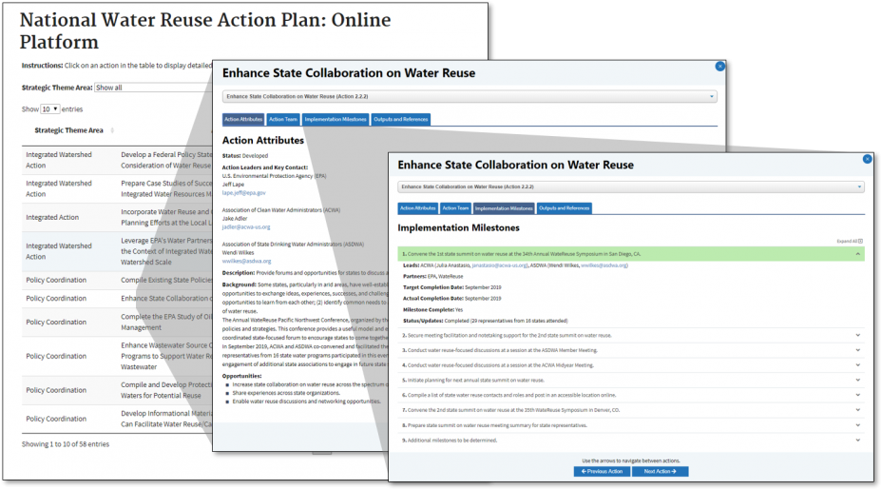
WRAP Online Platform
Repository for all actions (developed and undeveloped)
Provides background and opportunities to be gained
Identifies leaders, partners, interested collaborators
Captures milestones and progress
Helps form the pipeline of new actions and collaboration

Slide 10
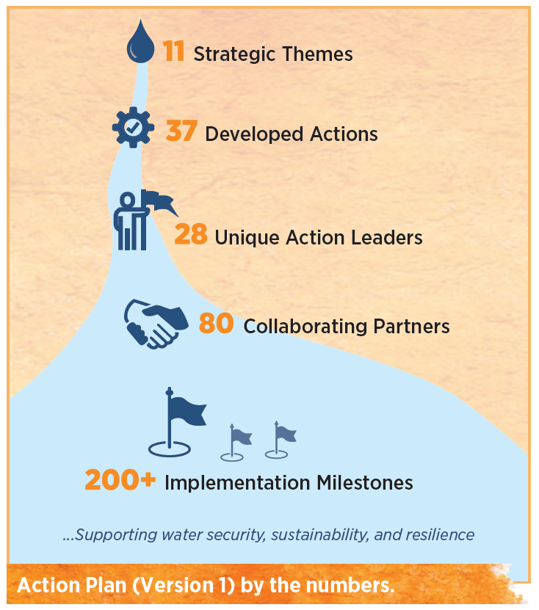
Action Implementation Plans
Version 1 fostered the development of “action implementation plans” to:
Demonstrate leadership for action.
Promote partnerships and collaborative actions that leverage the resources and expertise of many stakeholders.
Implement a means of demonstrating progress and accountability for the integrated actions.
Begin to create an enduring, dynamic, and iterative approach that will lead to subsequent versions of the WRAP.

Slide 11
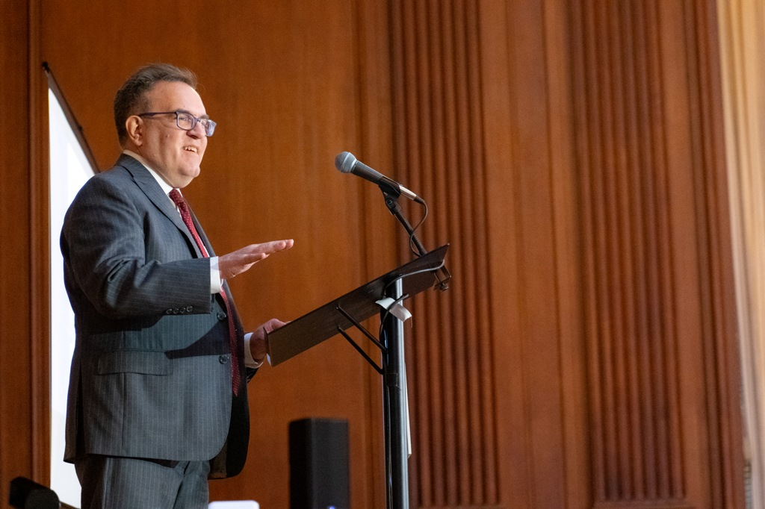
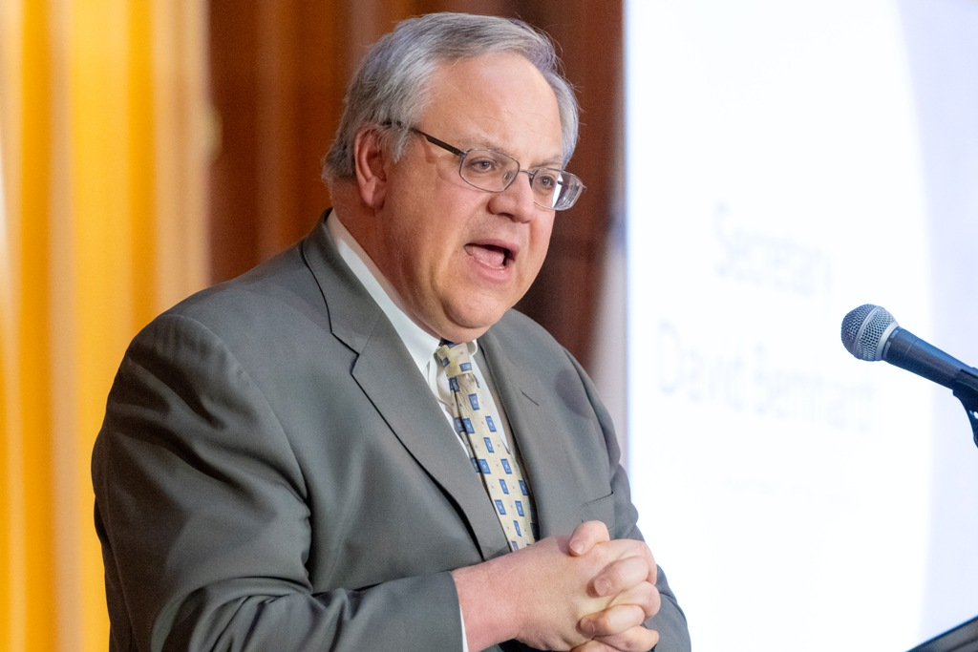
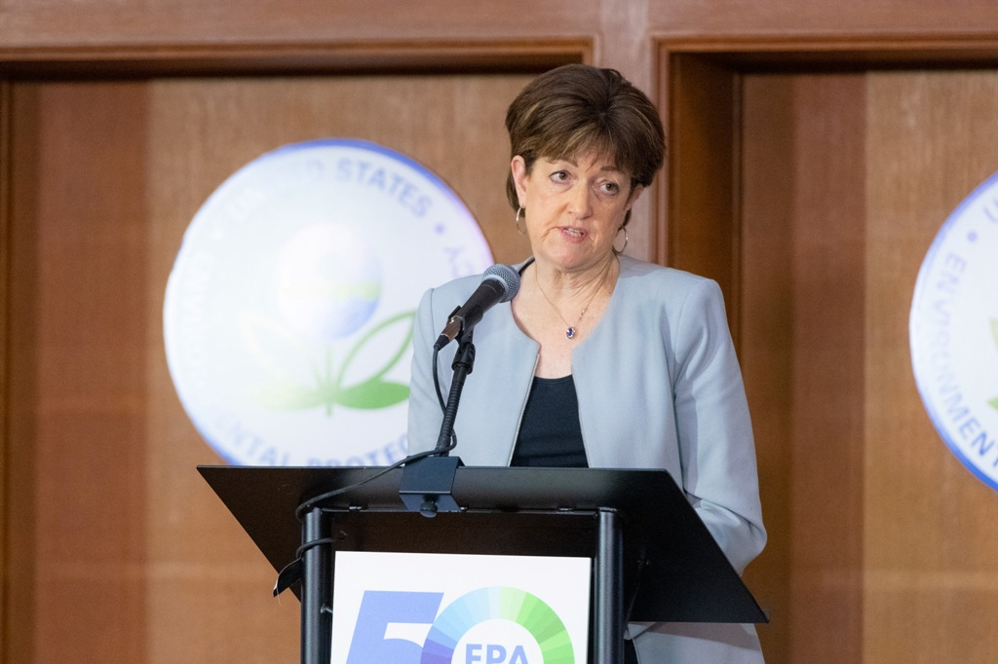
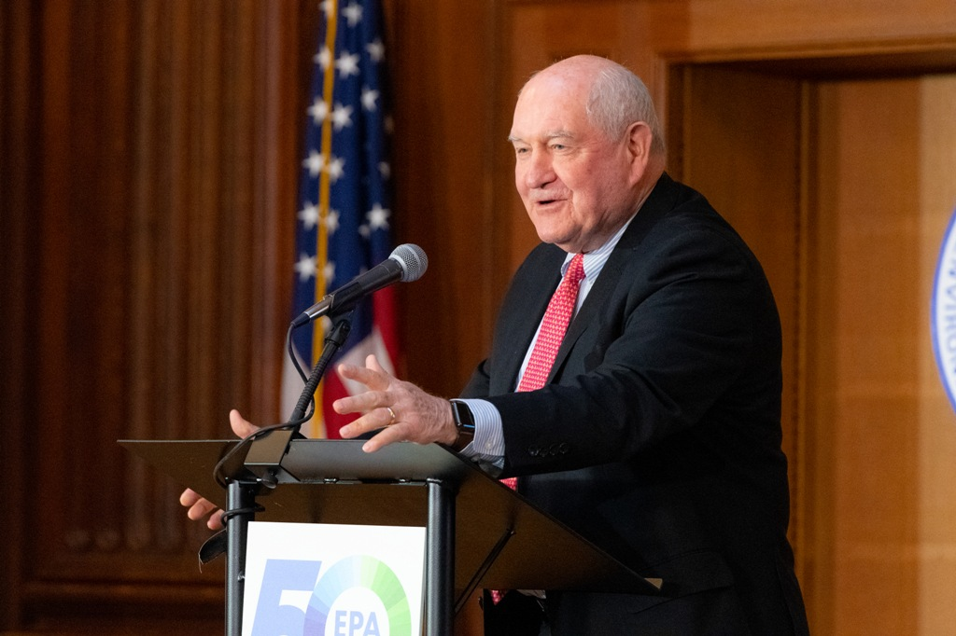
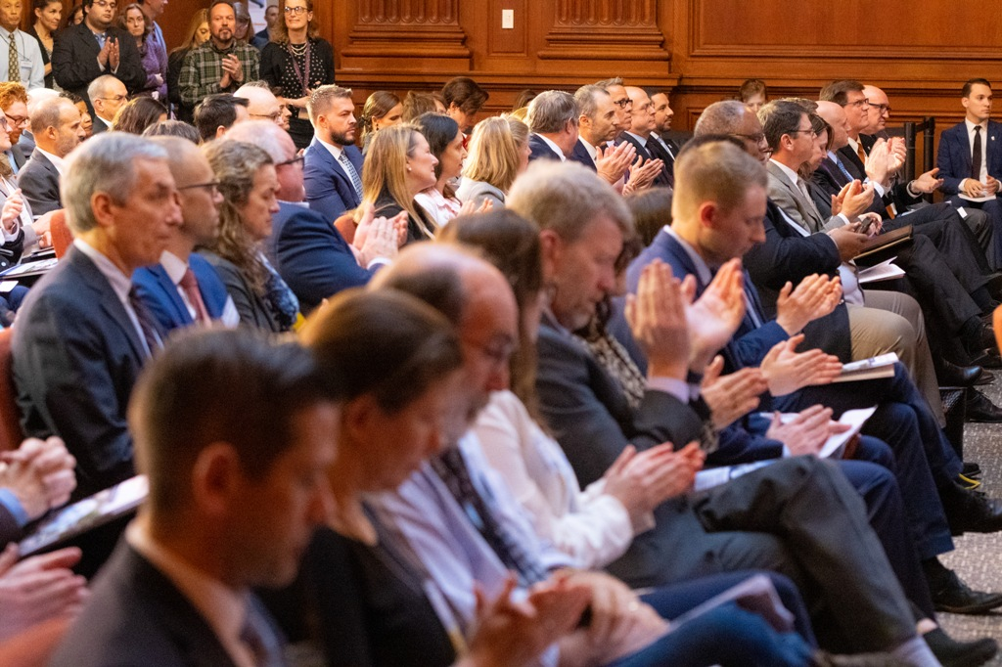
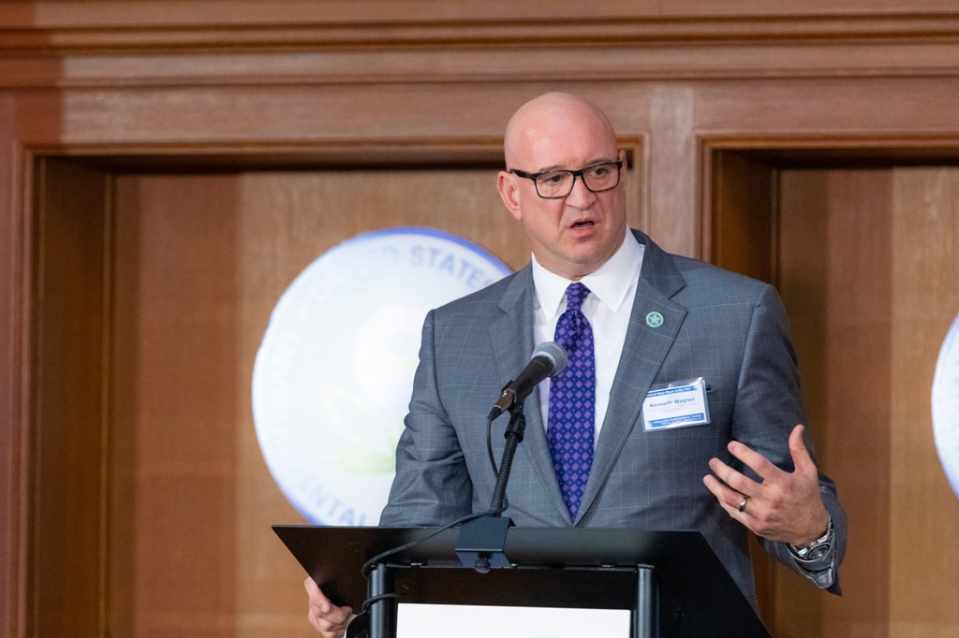
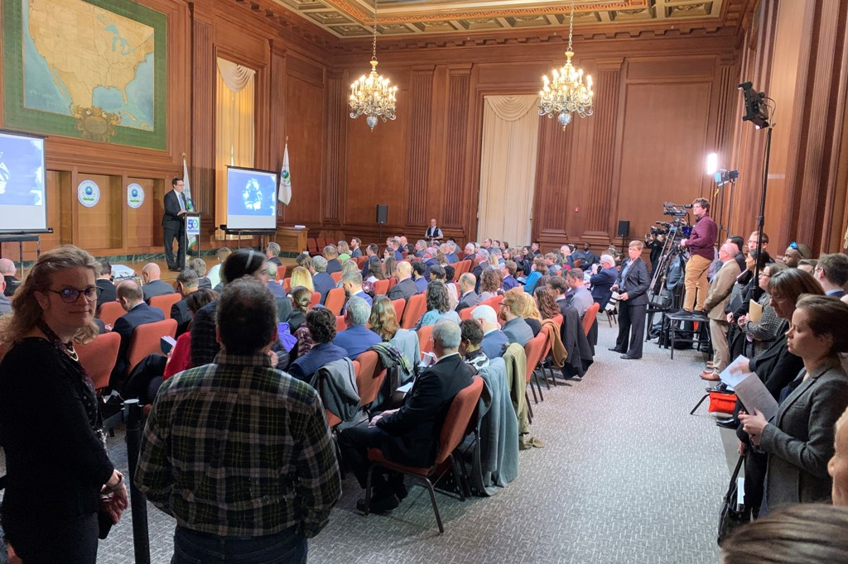
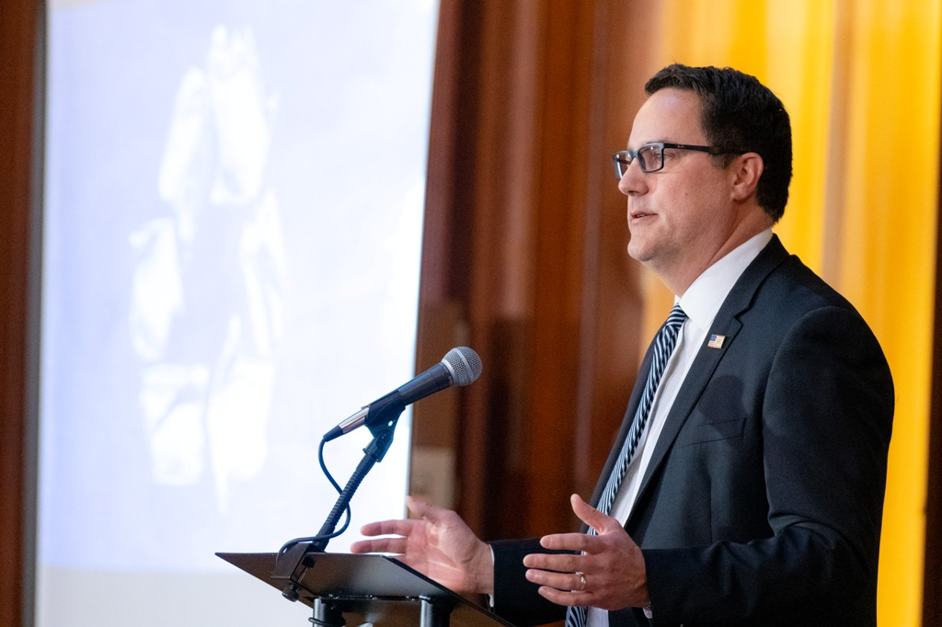
WRAP Launch Event – February 27, 2020

Slide 12
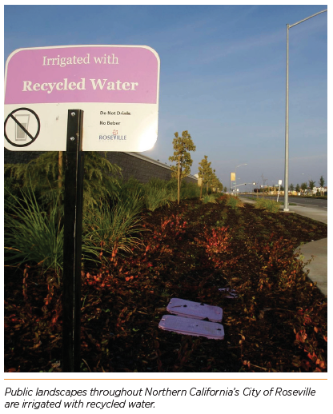
Water Reuse Collaborative Action Implementation
Section 2
The WRAP features 11 strategic themes:
2.1 Integrated Watershed Action
2.2 Policy Coordination
2.3 Science and Specifications
2.4 Technology Development and Validation
2.5 Water Information Availability
2.6 Finance Support
2.7 Integrated Research
2.8 Outreach and Communications
2.9 Workforce Development
2.10 Metrics for Success
2.11 International Collaboration

Slide 13
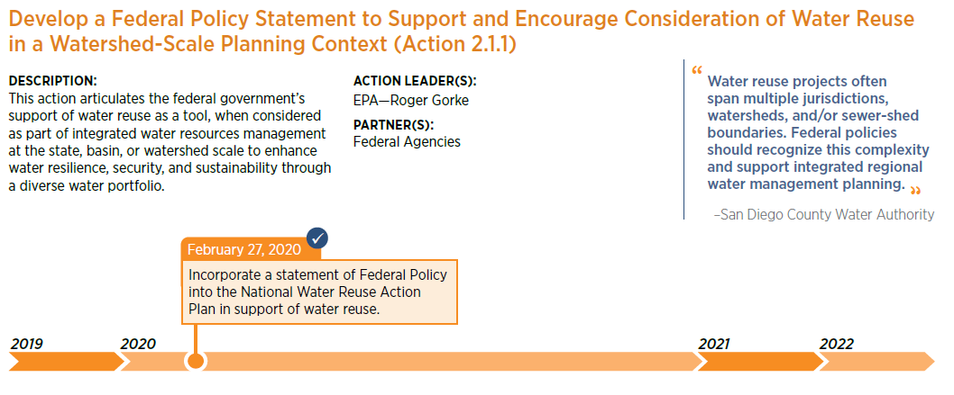
Examples of Developed Actions

Slide 14
Federal Policy Statement on Water Reuse
Water is critical to our nation’s health, strength, security, and resilience, but the solutions available to manage water and its availability are often complex. When incorporated into an integrated water management plan, water reuse can be a valuable tool to enhance the availability and effective use of water resources. The federal government recognizes, acknowledges, and respects the primacy of states in the management of water resources within their borders.
The federal government supports the consideration of water reuse to increase water security, sustainability, and resilience, especially when considered through integrated and collaborative water resource planning approaches, typically at the watershed or basin-scale.
This policy statement is intended to guide federal agencies to:
Encourage consideration of water reuse and integrated watershed-scale planning approaches;
Communicate the value and benefits of water reuse; and
Leverage existing programmatic, funding, and technical resources.

Slide 15
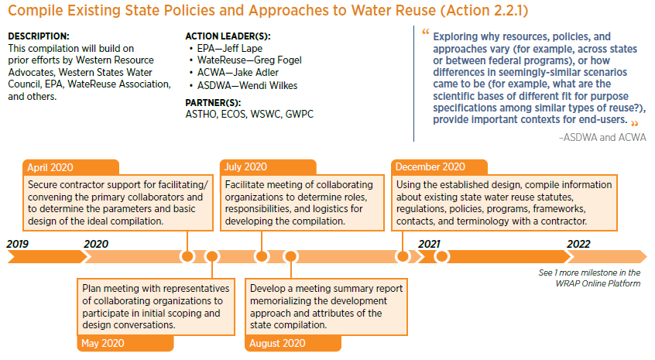
Examples of Developed Actions

Slide 16
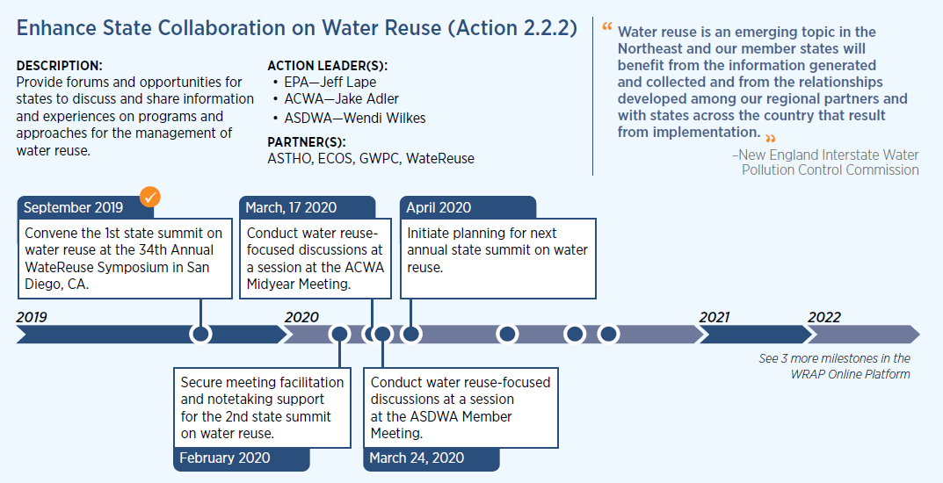
Examples of Developed Actions

Slide 17
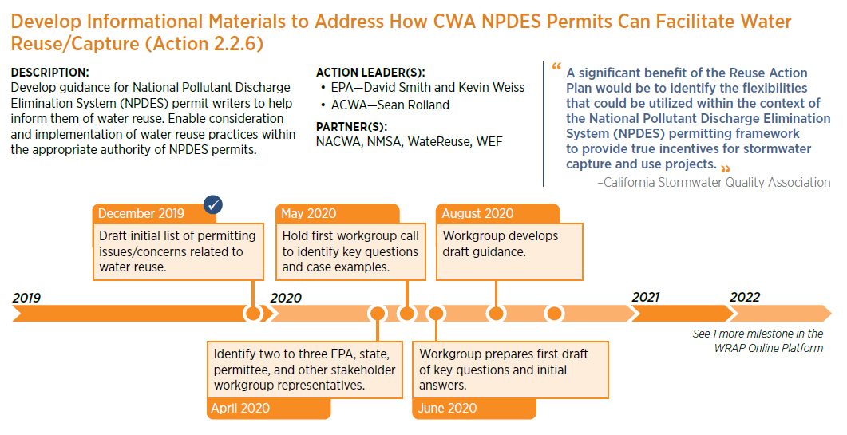
Examples of Developed Actions

Slide 18
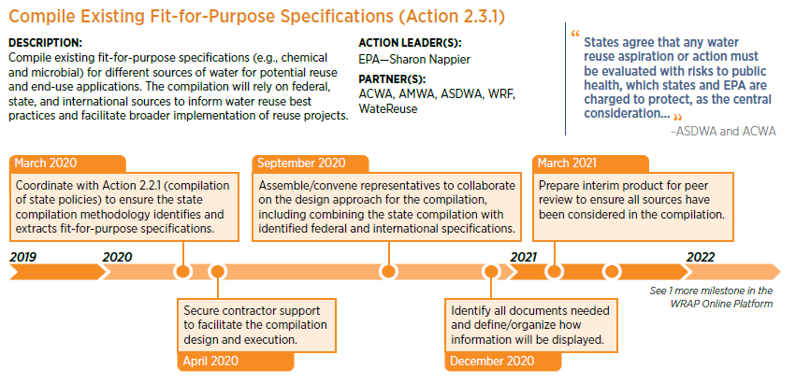
Examples of Developed Actions

Slide 19
Communicating Progress and Managing Forward
Print Product and Launch of the WRAP Online Platform
Identification of New Ideas for Actions
Adaptive and Iterative Management—Imagining Version 2
  September 2020:
    Annual WateReuse Symposium (Denver, Colorado) to report on action implementation progress
    Initiate development of Action Plan (Version 2)
    Start of next public comment period?
  April 2021: Release Version 2 during Water Week
Building an Enduring Legacy of Watershed-Based Action

Slide 20
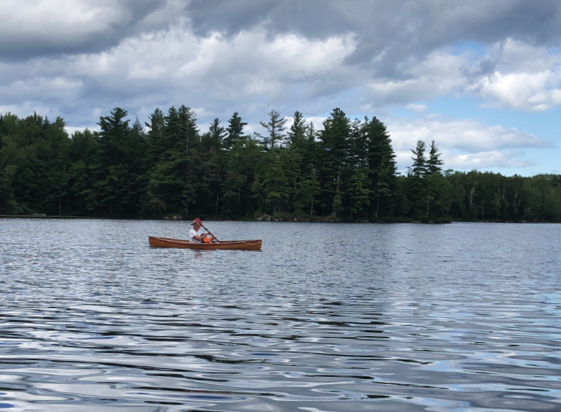
From Implementation to Institutionalization
EPA goal to institutionalize water reuse into the Office of Water operational culture
Exploring ways to embed reuse into the National Water Program
What does this look like across the water user community?

Slide 21
Get Involved!
Support implementation of developed actions
  Reach out to action leader(s) about status and next steps
Initiate scoping of undeveloped or new action ideas
  Share idea with WRAP team
  Begin to compile key information (e.g., leader/partner organizations and contacts, background, implementation milestones)
  Next suite of actions expected to be considered in fall 2020
Questions/comments about the effort
  Email waterreuse@epa.gov

Slide 22
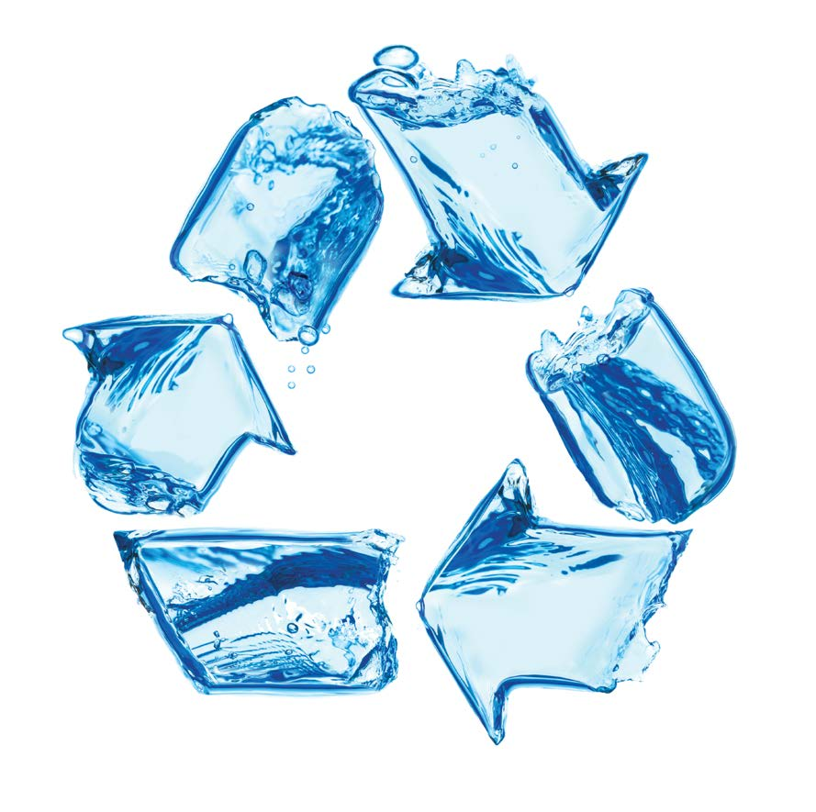
Thank You!
Jeff Lape, National Program Leader for Water Reuse
EPA Office of Water
lape.jeff@epa.gov
https://www.epa.gov/waterreuse/water-reuse-action-plan
waterreuse@epa.gov
Together, we can ensure the sustainability, security, and resilience of our Nation’s water resources.

Slide 23
Repository – Unused Slides

Slide 24
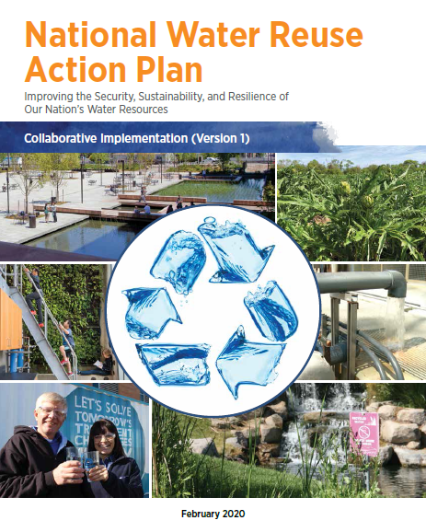
Agenda
Overview & background
Public comment period
Strategic themes & actions
Implementation

Slide 25
Opportunities and Key Terms
Water Reuse – Broadly Framed
Discussions of water reuse commonly include terms such as “recycled water,” “reclaimed water,” “purified water,” “alternative water supplies,” “improved water reliability,” and “water resource recovery.”
Sources of water for potential reuse can include municipal wastewater, industry process and cooling water, stormwater (including captured rainwater), agriculture runoff and return flows, and oil and gas produced wastewater. These sources are considered “reused” after they are assessed for a new use and treated and verified to meet the appropriate and applicable fit-for-purpose specifications (e.g., protection of public health) for the end use application. These fit-for-purpose specifications may be established by a regulatory or management entity (e.g., a state) or by the end user.
Examples of reuse applications include agriculture and irrigation, potable water supplies, groundwater storage and recharge, industrial process and cooling, onsite non-potable use, saltwater intrusion barriers, and environmental restoration.
Fit-for-Purpose Treatment Specifications​
Fit-for-purpose treatment specifications describe and quantify the water quality characteristics necessary to meet end use needs, including public health protection and environment/ecosystem protection. Appropriate monitoring (e.g., using applicable methods, happening at the right frequency) will verify whether fit-for-purpose specifications are being met.

Slide 26
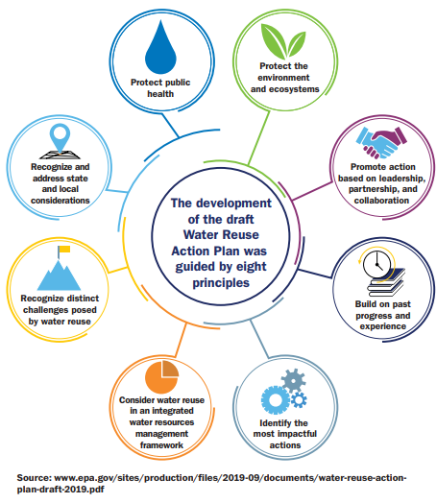
WRAP Guiding Principles
The guiding principles from the draft Action Plan were expanded based on public comment. Three new principles:
Commit to implementation through transparency and shared accountability.
Communicate effectively.
Apply adaptive management and governance.
      Image source: https://awwa.onlinelibrary.wiley.com/doi/abs/10.1002/awwa.1426

Slide 27
90-Day Public Comment Period
Commenters were encouraged to:
Identify the most important proposed actions they feel should be taken in the near term
Identify the specific attributes and outcomes of proposed actions that will achieve success
Identify implementation steps and milestones necessary to implement the proposed actions
Commit to lead or collaborate with others on implementing any of the proposed actions
Inform revisions and recommendations to the proposed 46 actions
101 comments were received, averaging 5 pages in length.

Slide 28
90-Day Public Comment Period
Thematic Highlights of the Public Docket Comments:
Widespread Support for the WRAP and Water Reuse as a Tool for Water Security, Sustainability, and Resilience
Affirmation That Water Reuse Is One Tool in the Water Resource Toolbox
Acknowledgement of Incorporating Prior Public Comments
Defining and Reconciling Key Terms
Emphasis on and Identification of Priority Actions
Spectrum of Perspectives on the Potential for Reuse of Oil and Gas Produced Wastewater
Recognition of Barriers/Challenges to Water Reus
Public Commitments to Lead or Support Actions
Identification of New Proposed Actions
Not Setting Goals for Water Reuse at This Time

Slide 29
Integrated Watershed Action
2.1
Example Action:
Prepare Case Studies of Successful Water Reuse Applications Within an Integrated Water Resources Management (IWRM) Framework (Action 2.1.2)
Action Leader: WateReuse
“We support this plan because it integrates water reuse opportunities across multiple sectors including drinking water, agriculture, industry, recreation, and environmental protection.”
−State of Oklahoma, Office of the Secretary of Energy & Environment
Rainwater catchment project near Pennington Creek, California, installed in partnership with the Morro Bay National Estuary Program, stores up to 296,000 gallons of rainwater for cattle troughs in the dry season.

Slide 30
Policy Coordination
Example Action:
Enhance Wastewater Source Control through Local Pretreatment Programs to Support Water Reuse Opportunities for Municipal Wastewater (Action 2.2.4)
Action Leaders: NACWA, WEF
“Exploring why resources, policies, and approaches vary (for example, across states or between federal programs), or how differences in seemingly-similar scenarios came to be (for example, what are the scientific bases of different fit for purpose specifications among similar types of reuse?), provide important contexts for end-users.”
−ASDWA and ACWA
As part of the “Don’t Rush to Flush” campaign, pills are collected in a pharmaceutical drop box and properly disposed instead of entering the wastewater system.

Slide 31
Science and Specifications
2.3
Example Action:
Develop Research and Tools to Support the Implementation of Onsite Non-Potable Water Reuse Systems (ONWS) (Action 2.3.4, previously 2.6.5)
Action Leader: NBRC for ONWS
“ Governments at all levels and non-governmental organizations should draw on the sound science and long history of water reuse in different parts of the country that can provide the basis for greater acceptance of this water management approach. ”
−National Groundwater Association
The San Francisco Public Utilities Commission building irrigates exterior vegetation using onsite water reuse.

Slide 32
Technology Development and Validation
2.4
Example Action:
Support Water Reuse Through the U.S. Department of Energy’s Water Security Grand Challenge (Action 2.4.3)
Action Leader: DOE
“Technology validation processes can be complicated and variable between individual states; this issue presents an opportunity for EPA to assist in streamlining and standardizing technology validation processes to enable faster adoption of new technologies.”
−Denver Water
GlaxoSmithKline (Upper Providence, Pennsylvania) air handler condensate is reused by their cooling towers, resulting in 9 million gallons water savings in 2019, equivalent to $140,000 in cost savings and a 14.3 percent reduction in water use.

Slide 33
Water Information Availability
2.5
Example Action:
Develop National Integrated Water Availability Assessments (New Action 2.5.4)
Action Leader: USGS
“Using data to target watersheds with reuse potential could provide for more efficient use of state resources.”
−New Mexico Environment Department
Terraces, buffers, and conservation tillage are among the practices being used by Shelby County, Iowa, farmers in a water quality improvement project to benefit a nearby lake.

Slide 34
Finance Support
2.6
Example Action:
Compile and Promote Existing U.S. Department of Agriculture Funding and Resources for Rural Communities (Action 2.6.4)
Action Leader: USDA
“Technology validation processes can be complicated and variable between individual states; this issue presents an opportunity for EPA to assist in streamlining and standardizing technology validation processes to enable faster adoption of new technologies.”
−Denver Water
Acting EPA Administrator Andrew Wheeler signs a $614 million WIFIA loan to the City of San Diego alongside Mayor Kevin Faulconer.

Slide 35
Integrated Research
2.7
Example Action:
Develop a Coordinated National Research Strategy on Water Reuse (Action 2.7.2)
Action Leader: WRF
“Developing a coordinated research strategy on water use and reuse could provide a starting point from which future efforts to expand water reuse could be compared. A common research strategy could also help to inform potential water reuse approaches at the state and municipal levels.”
−National Association of Home Builders
The Brackish Groundwater National Desalination Research Facility develops technologies for the desalination of brackish and impaired groundwater found in the inland states.

Slide 36
Outreach and Communications
2.8
Example Action:
Establish a Water Reuse Champion Award Program
for Private Sector Companies (New Action 2.8.4)
Action Leaders: GreenBiz, WateReuse
“More messaging on a national level of the benefits and successes [of water reuse] in tandem with discussion of the public health and environmental protection safeguards and benefits is necessary.”
−NACWA
El Paso’s TecH2O Learning Center hosts thousands of students for field trips every year, helping next generation water customers appreciate the value of water.

Slide 37
Workforce Development
2.9
Example Action:
Support and Promote Opportunities for Creating a Skilled Workforce for Water Reuse Applications (Action 2.9.2)
Action Leaders: EPA, WateReuse, AWWA, WEF
“With increasingly complex systems, particularly in the case of direct potable reuse, there are skills, knowledge and abilities that go beyond traditional operator certification requirements. ACWA and ASDWA recognize and respect the States’ autonomy in implementing their operator certification programs, however water reuse represents a unique opportunity for EPA to partner with states to identify key knowledge and skills needed by water system operators who are presiding over these water reuse projects.”
−ACWA and ASDWA
Denver Water contractors install a purple pipe used to deliver recycled water in northeast Denver, Colorado

Slide 38
Metrics for Success
2.10
Example Action:
Facilitate Implementation of the National Water Reuse Action Plan (Action 2.10.3)
Action Leader: EPA
“According to the 2017 Reuse Inventory Report, Florida reused approximately 813 MGD (over 161 billion gallons per year) of potable quality water while serving to add 252 MGD (approximately 92 billion gallons per year) back to available water supplies.”
−Florida DEP
Breakout session at one of the WateReuse expert convenings on water reuse during development of the draft Action Plan.

Slide 39
International Collaboration
2.11
Example Action:
Raise Global Awareness and Preparedness for Water Reuse and the Water Reuse Action Plan (New Action 2.11.2)
Action Leader: DOS
“The Chamber recommends that EPA continue to cooperate with leading organizations and countries (e.g., Israel) to ensure implementation of the most effective reuse solutions and associated funding options.”
−U.S. Chamber of Commerce Business Task Force on Water Policy
The 2019 water management project in Kyrgyzstan is part of the Ambassador’s Water Experts Program, which supports the U.S. Government’s Global Water Strategy priorities.

Slide 40
Action Leader Roles
Coordinating among the action team.
Facilitating implementation of the milestones.
Seeking and including new partners to collaborate with, where appropriate.
Providing updates on progress and outputs.
Validating action leader responsibilities with subsequent versions of the WRAP.

