Slide 1
Arizona Department of Environmental Quality
The Navigable Waters Rule and
Protection of Surface Waters in Arizona
March 17th, 2020
Association of Clean Water Administrators Midyear Meeting
Notes:
Meeting Purpose:
To provide an update on the WOTUS Rule and final analysis on impacts
Update on the gap and the risk to state
Update on legislative activity
Report on input received to date
Introduce work group structure
Timeline of next steps

Slide 2
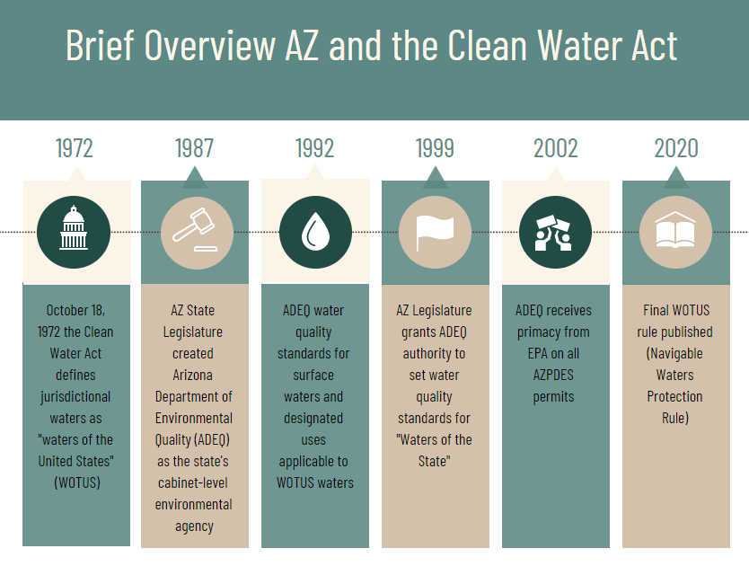
CLEAN WATER ACT HISTORY

Slide 3
CURRENT WOTUS RULE IN AZ
Traditional Navigable Waters and Adjacent Wetlands
Perennial and Intermittent Tributaries and Certain Wetlands
Ephemeral Tributaries and Wetlands with a Significant Nexus

Slide 4
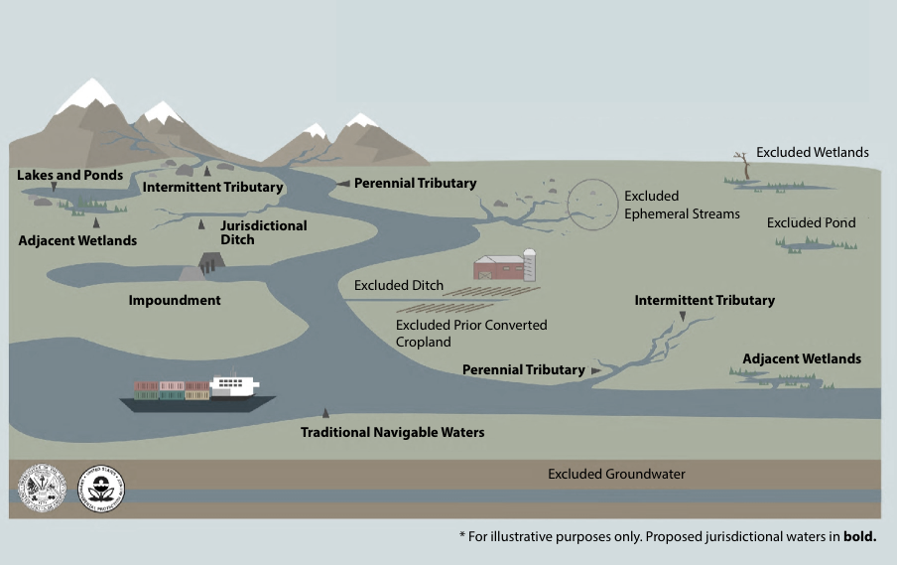

NAVIGABLE WATERS PROTECTION RULE
TNWs
Ephemeral breaks
Typical year

Slide 5
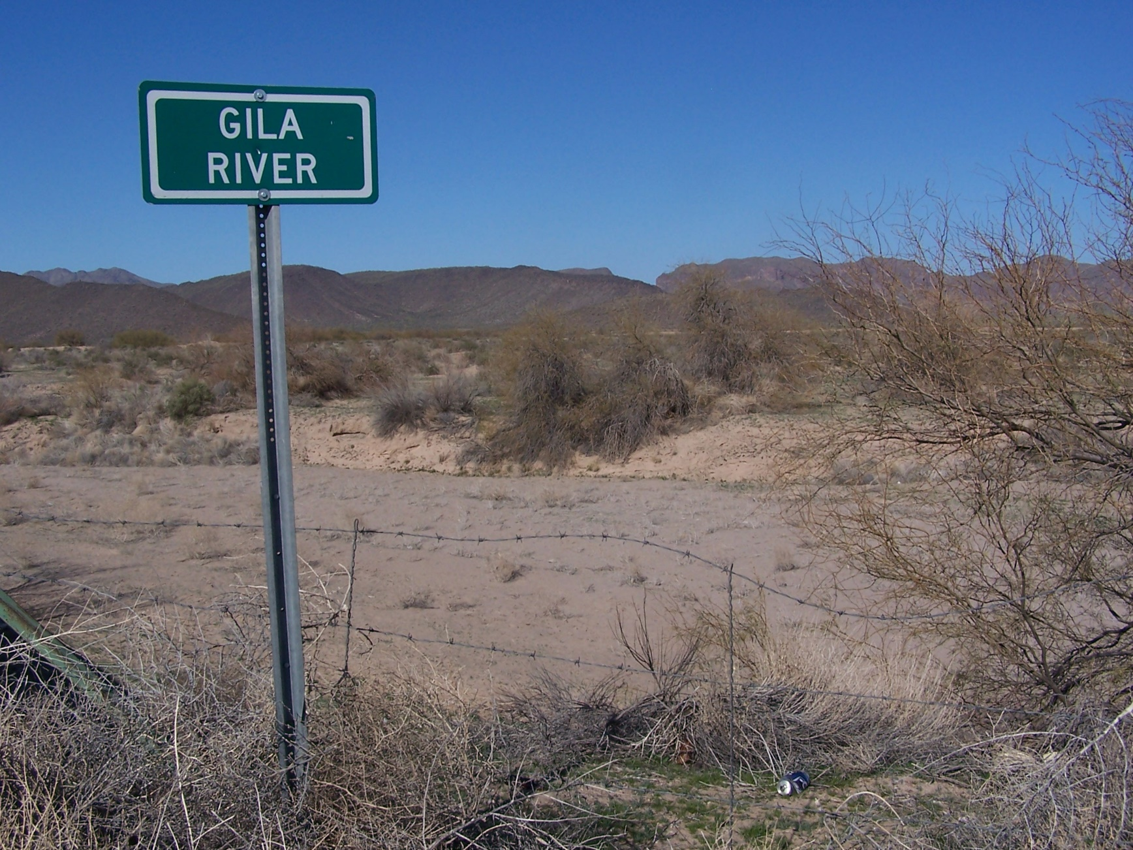
Arizona Examples

Slide 6
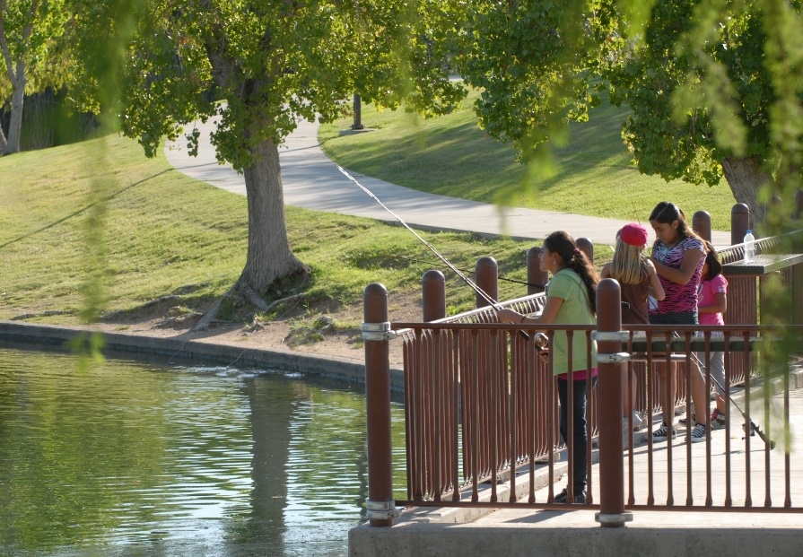
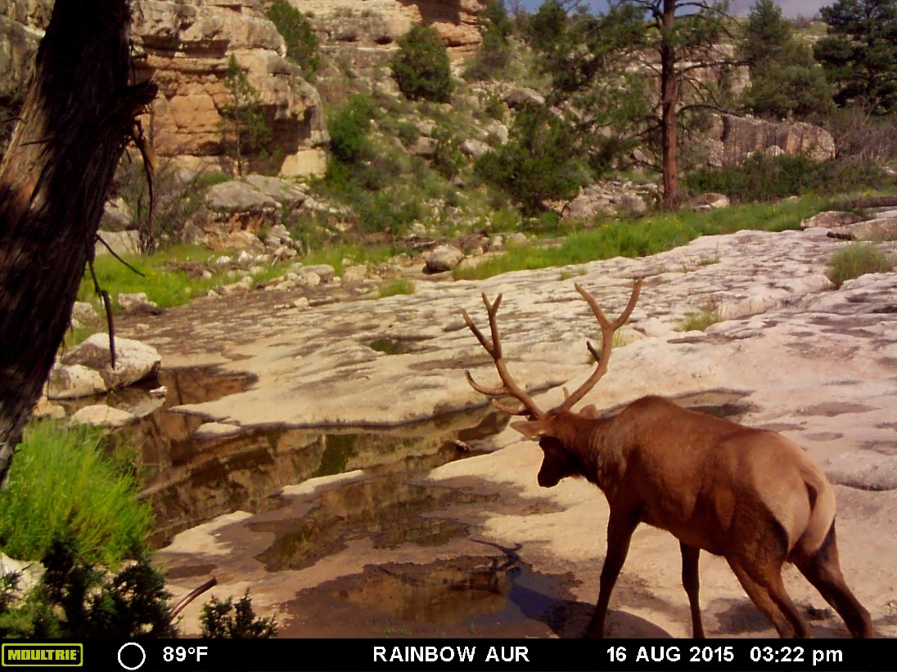
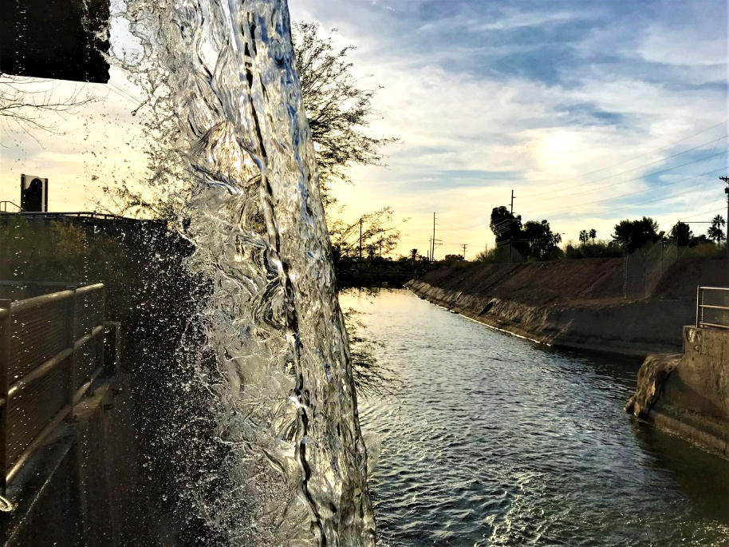
Arizona Examples
Intermittent Stream
Jacks Canyon
Urban Lake
Red Mountain Park
Photo courtesy of AZGFD
Canal
AZ Falls

Slide 7
Current Surface Water Quality Protection in Arizona
Point Source Permits
Yes
TMDLs*
Dredge and Fill Permits
Yes**
Enforce Standards
No
Yes
Yes
No
No
Set Water Quality Standards
Yes
Yes
Nonpoint Source Grants
No
Standards Certs. for Federal Permits
Yes
Yes
Yes
No
WOTUS
Non-WOTUS
* Total Maximum Daily Loads for waterbodies
** Currently administered by the U.S. Army Corps of Engineers

Slide 8
CURRENT ADEQ PROGRAMS/AUTHORITIES
Aquifer Protection Program
Nuisance authority
Standards setting authority
Monitoring authority
Enforcement authority

Slide 9
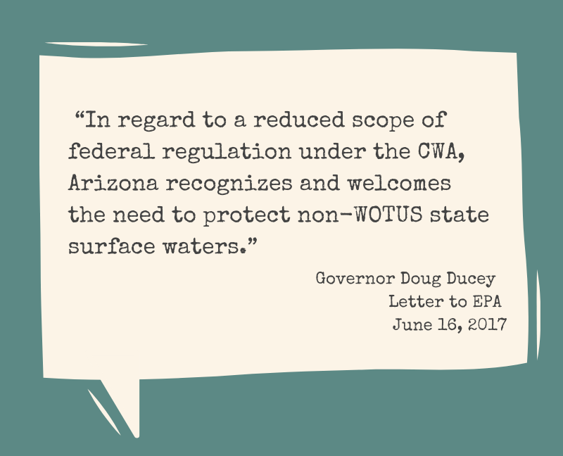
Governor Ducey on Waters of the State

Slide 10
IMPORTANCE OF A STATE PROGRAM
November 2019 Stakeholder Input
  91% important to have a state program

Slide 11
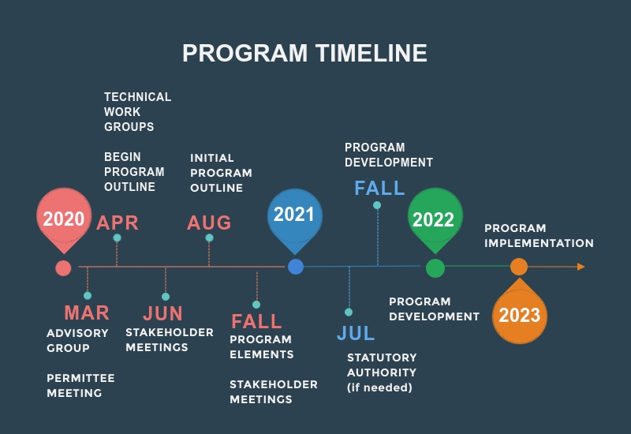
Notes:
March-April – Advisory group
May –stakeholder meetings & Workgroup formation if needed
August – full program outline & stakeholder meeting

Slide 12

More Information
Email: watersofarizona@azdeq.gov
ADEQ Waters of Arizona Website: https://azdeq.gov/woaz
Urban Lake
Photo courtesy of AZGFD
Intermittent Stream Jacks Canyon
Photo courtesy of Arizona Parks
Notes:
Kiwanis Lake – urban isolated lake – non-wotus
Slide Rock/Oak Creek – may be non-wotus; recreation area to protect

