Slide 1
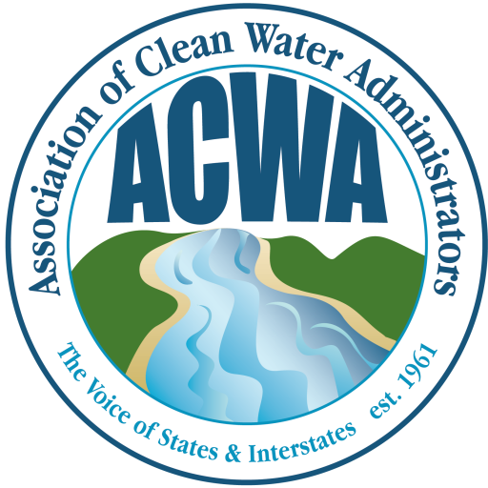
Residual Designation Authority Litigation Update
Robert G. Brown, Deputy Assistant Commissioner
Bureau of Water Resources
Massachusetts Dept. of Environmental Protection

Slide 2
THE EVOLUTION OF THE FEDERAL STORM WATER PROGRAM 1972 - 1987
1973 - 1st Attempt at Federal Storm Water Regulations
1976 - 2nd Attempt at Federal Storm Water Regulations
1984 - 3rd Attempt at Federal Storm Water Regulations
1985 - 1st Federal TMDL Regulations

Slide 3
THE EVOLUTION OF THE FEDERAL STORMWATER AND TMDL PROGRAMS POST-1987
1990 - Final Phase I Stormwater Regulations
1999 - Final Phase II Stormwater Rule
2000 - Final TMDL Regulations
2003 - EPA withdraws the July 2000 TMDL Regulations

Slide 4
THE RESIDUAL DESIGNATION AUTHORITY
1973 - First Federal Storm Water Regulations
1976 - Second Federal Storm Water Regulations
1984 - Third Federal Storm Water Regulations
1987 - Water Quality Act of 1987
1990 - Final Phase I Storm Water Regulations
1999 - Final Phase II Storm Water Rule

Slide 5
1973 RDA
EPA exempted from permit requirements those conveyances carrying storm water runoff uncontaminated by industrial or commercial activity . . . unless the particular storm water discharger had been identified by the permitting authority as a significant contributor of pollution
“Significant contributors” were to be identified by the States in connection with the development of plans under § 303(e)

Slide 6
1976 RDA
Regulations require permits for two types of storm water discharges:
separate storm sewers in an urbanized area and any other discharge to a separate storm sewer designated as a significant contributor of pollution by the permitting authority on a case-by-case basis; and
conveyances used for conveying storm water contaminated by contact with wastes, raw materials or contaminated soils from industrial or commercial areas
The 1976 regulations carried over the “designation” provision but was silent as to how “significant contributors” would be identified.

Slide 7
1984 RDA
Regulations requiring permits for “storm water point sources”
Includes discharges from urbanized areas, land or activities used for industrial or commercial activities, or as otherwise designated by the permitting authority on a case-by-case basis
May designate if a Water Quality Management plan under section 208 contains requirements or if the discharger is a significant contributor of pollution to the waters of the United States.

Slide 8
§ 402(p) under the Water Quality Act of 1987
Mandates a two-phase regulatory approach to stormwater: (1) Phase I Large and Medium MS4s; and (2) Phase II Small MS4s
The Phase I Moratorium Period: Prior to October 1, 1994, the Administrator or the State (in the case of a permit program approved under this section) shall not require a permit under this section for discharges composed entirely of stormwater
Exceptions During the Moratorium Period - Section 402(p)(2)(E): Discharges for which the Administrator or the State, as the case may be, determines that the stormwater discharge contributes to a violation of a water quality standard or is a significant contributor of pollutants to WOTUS

Slide 9
RDA UNDER THE PHASE I REGULATIONS
Codified the statutory authority of section 402(p)(2)(E) of the CWA for the Administrator or the State Director
Petition for Designation
Any operator of an MS4 may petition the permitting authority to require a separate NPDES permit (or a permit issued under an approved NPDES State program) for any discharge into the MS4
Any person may petition the permitting authority to require a NPDES permit for a discharge which is composed entirely of storm water which contributes to a violation of a water quality standard or is a significant contributor of pollutants to waters of the United States

Slide 10
RDA UNDER THE PHASE I REGULATIONS
Procedures for Designation
Requires that whenever the permitting authority decides that an individual permit is required, the permitting authority shall notify the discharger in writing that the discharge requires a permit and the reasons for the decision. In addition, an application form is sent with the notice; provides a 60 day period from the date of notice for submitting a permit application

Slide 11
Pre-enforcement Review under the APA
In the 2012 Sackett decision, the Supreme Court held that an EPA administrative compliance order issued under the CWA is “final” for purposes of APA judicial review

Slide 12
Pre-enforcement Review under the APA
In the 2016 Hawkes decision, the Supreme Court held that a party is entitled to judicial review of an approved jurisdictional determination by the Corps
Prior to the decision, a majority of the U.S. Circuit Courts of Appeals held that a JD was not “final agency action” that could be challenged in court

Slide 13
Section 402(p)(6)
Congress required EPA to “establish a comprehensive program to regulate such designated sources”
EPA completed studies and submitted a report to Congress in 1995
EPA promulgated Phase II regulations in 1999 designating certain small MS4s and small construction sites for NPDES permitting
As part of the comprehensive program required by Congress, EPA further reserved the RDA to require permits for otherwise unregulated stormwater discharges on a case-by-case basis

Slide 14
RDA UNDER THE PHASE II REGULATIONS
40 CFR § 122.26(a)(9)(i)(C) - stormwater discharges may be designated where the Regional Administrator or State Director determines “that stormwater controls are needed for the discharge based on wasteload allocations that are part of [TMDLs] that address the pollutant(s) of concern . . .”
40 CFR § 122.26(a)(9)(i)(D) - stormwater discharges may be designated where the Regional Administrator or State Director determines that “the discharge, or category of discharges within a geographic area, contributes to a violation of a water quality standard or is a significant contributor of pollutants to waters of the United States.”

Slide 15
Los Angeles Waterkeeper v. Pruitt
Arose from EPA Region 9’s rejection of a petition for EPA to exercise its RDA to regulate stormwater discharges from CII sites in two Southern California watersheds
EPA found that CII sites contributed to violations of water quality standards in both bodies of water but nonetheless declined to require NPDES permits from CII sites
EPA determined that the impairment was adequately addressed by NPDES permits issued for MS4s in the watersheds and several other statewide permits

Slide 16
Blue Water Baltimore, Inc. v. Wheeler
Plaintiffs’ suit seeks to force EPA to require any privately owned CII sites in Baltimore County’s Back River watershed to obtain NPDES permits for their stormwater runoff
If EPA imposed this requirement, the state permitting authority, the Maryland Department of the Environment, would be required to develop, issue, and administer permits for these sites, even though most of those sites already discharge into a permitted MS4

Slide 17
U.S. District Court for the Central District of California
EPA possesses discretion to exercise its RDA
EPA’s finding that CII sites contributed to violations of water quality standards left the Agency with only two options:
issue NPDES permits for the contributing stormwater discharges; or
prohibit the discharges

Slide 18
U.S. District Court for the Central District of California
The court read CWA Sections 301 and 402 not to afford EPA discretion to leave unregulated a source of stormwater found to contribute to violations of WQS
The court ruled the text of Section 402(p)(2)(E) limits the factors that EPA may consider strictly to whether a stormwater discharge contributes to a violation of WQS or is a significant contributor of pollutants

Slide 19
Lizzie Borden took an axe
EPA: the CWA does not list any “factors” that EPA may or may not consider

Slide 20
Did she do it?
Did Congress prohibit EPA from considering relevant information, such as existing state programs that address stormwater discharges?

