Slide 1
ACWA Partners Update
2020 Mid-Year Meeting Webinar
J. Alan Roberson, P.E.
ASDWA Executive Director

Slide 2
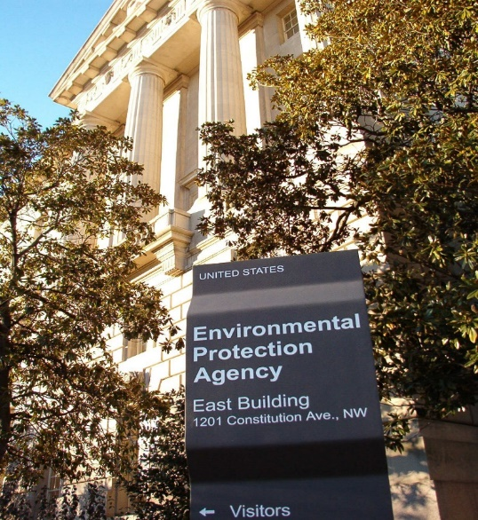
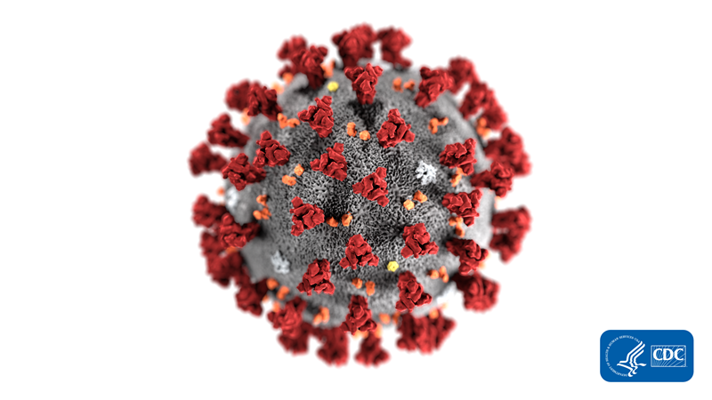
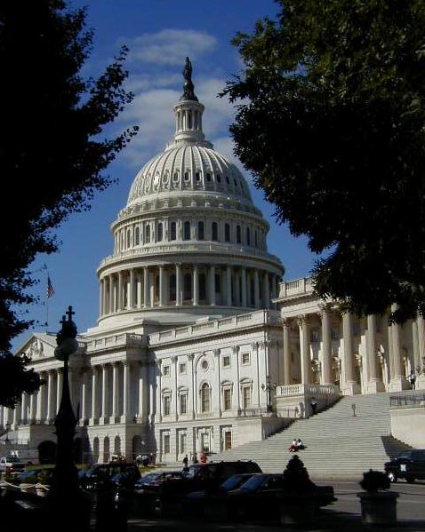
Presentation Outline
Congressional issues
  Funding
EPA issues
  Perchlorate
  Lead
    SDWIS
  PFAS
  Legionella
  OECA
  Cooperative federalism
COVID-19

Slide 3
Congress in 2019
2019 – improved relationships with Hill staff
  Lisa Daniels PFAS testimony to Senate EPW
Omnibus FY 20 appropriations
  4.2% increase in PWSS funding in FY20
    From $ 101.96 million to $106.25 million
  DWSRF funding remained the same
    $1.164 billion
  Submitted FY 21 appropriations testimony
NDAA and PFAS
  This issue isn’t going away

Slide 4
Congress in 2020
Outlook for Congress in 2020
  Who really knows?
  November election used to be the driver
    COVID-19 upending everything
Continuing Resolution (CR) likely
  CR would likely go thru election
    But could go deep into 2021 due to election
WRDA 2-year cycle in 2020
  Last two cycles resulted in WIIN and AWIA
    More SDWA changes being kicked around

Slide 5

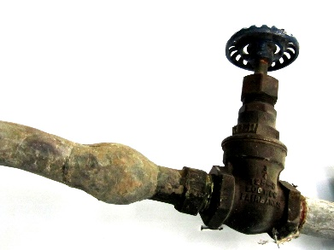
EPA Regulations in 2019
Perchlorate - proposed on 6/26
  Four proposed options
    Proposal: 56 ug/L
      Options: 18 & 90 ug/L and negative regulatory determination
  Court deadline for final – June 19, 2020
Lead and Copper Rule Revisions (LCRR)
  Proposed on 11/13
    EPA granted a 30-day extension to comment period
  Recent testimony by EPA Administrator Wheeler
    Final rule will come out “this summer”
      78,192 comments received

Slide 6
EPA’s Six Focus Areas for LCRR
Identifying high-risk areas
  Lead service line inventories
  Find-and fix homes with high lead
Strengthening corrosion control treatment
Lead service line replacement
Increasing sampling reliability
Improving risk communications
  24-hour public notification
Testing requirements for schools and child care facilities

Slide 7
ASDWA’s LCRR Comments
ASDWA’s comments – 80 pages
Four focus areas
  “Together, let’s get the lead out”
  Public communications are key
  Reduce states’ implementation burden and increase funding
  Data handling and data management
    Going into a little detail on the last two

Slide 8
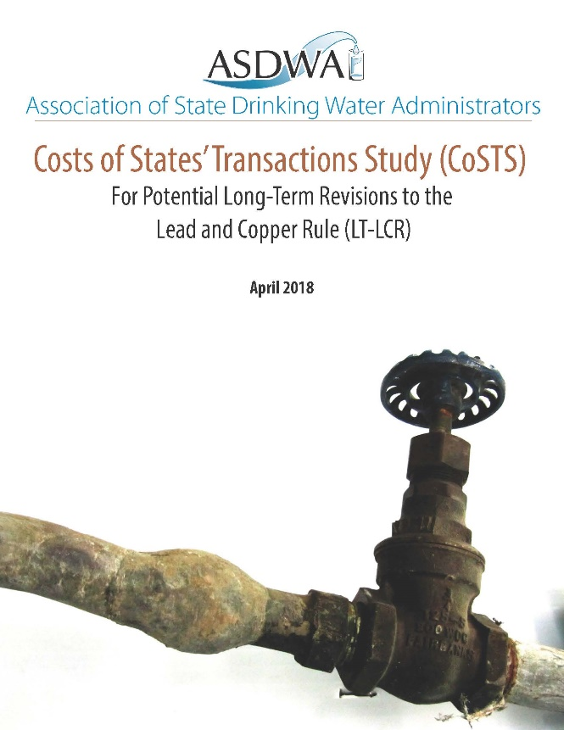
LCRR-Reduce Burden & Increase $
Proposed LCRR increases complexity
  Tracking, reviews and approvals, assistance, compliance, periodic re-reviews for most of parts of proposed LCRR
Annual increase in state hours +835,000 hrs.
  Factor of 12 greater than current LCR
  LCRR would cost states +$50 million annually
    +47% of current PWSS funding
      ASDWA’s recommendations reduce burden +12%
Lots of guidances for LCRR implementation will be necessary to reduce the burden

Slide 9
LCRR-Data Management
Almost all components of proposed LCRR will require data handling/management
  Systems (labs), states, and EPA
SDWIS isn’t currently able to fully implement the proposed LCRR
  Implementation will be challenging due to early implementation activities such as LSL inventories
SDWIS Modernization still has lots of questions to be answered

Slide 10
SDWIS Modernization
CMDP and SDWIS Prime Transition
  Contract shifting from Attain to Systalex
SDWIS Prime and Business Rules Engine Technical Assessment
  Analysis report completed and options being further explored
SDWIS Modernization Board
  Getting off the ground to provide subject matter expertise to EPA
2020 Data Management Users Conference
  Targeting somewhere in the Midwest sometime in September
Register for All Things SDWIS Webinar Series for 2020

Slide 11
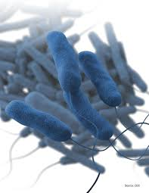
PFAS & Legionella
PFAS
  EPA’s PFAS Action Plan
    Both regulatory and non-regulatory actions in the Action Plan
    What are the most important actions for the water sector
  3/10 Federal Register notice for preliminary positive regulatory determinations for PFOA and PFOS and 6 other contaminants
    Comments due 5/11
  Summer: proposed UCMR5 will likely include several PFAS
Legionella
  Building plumbing water quality issue
    Outside of the control of the water system and the primacy agency
  CMS memo requiring water quality mgmt. plans for health care
    Hotels, dorms, offices, etc.?
  NASEM report makes several significant recommendations
  It’s not a problem until it is

Slide 12
OECA
National Compliance Initiative (NCI)
  ASDWA members and staff have been talking with OECA staff about the drinking water NCI for a couple of years
    Dialogue throughout 2019
    Letter to Susan Bodine, Asst. Admin. for OECA in August 2019
    State-EPA Roundtable at October 2019 Annual Conference
    Board-OECA conference call in January 2020
  Draft NCI sent for states’ review on 3/13 – asking for more time
  Still lots of NCI questions to be answered
    Ongoing variability with Regional approach to implementation
    Lots of questions about the OECA inspectors
    How does the NCI link to OW goal of 25% reduction of violations of HBS?

Slide 13
Cooperative Federalism
This topic seems to have been discussed less in 2019 and 2020 (so far)
  Others may have a different opinion
Flat funding for EPA creates resource issues
  LCRR
    Guidances
  SDWIS modernization
ASDWA State CEC Rule Development and Management Strategies Toolkit

Slide 14
Updated State Resource Needs Report
Project started in February 2019
  Cadmus in Contractor (same as before)
How have states’ resource needs changed since 2013?
  Unregulated contaminants
    PFAS, cyanotoxins and others
  Proposed Lead and Copper Rule Revisions (LCRR)
Draft report completed & under review
  Final report in April/May

Slide 15
State CEC Toolkit
Eight modules in the toolkit
  Module 1: Conduct a Self-Assessment of Regulatory Context and Capacity and Address Current Public Health Concerns as Needed
  Module 2: Characterize Health Effects
  Module 3: Characterize Occurrence
  Module 4: Identify Analytical Methods
  Module 5: Characterize Treatment and Compliance Options
  Module 6: Characterize Benefits, Costs, and Economic Considerations
  Module 7: Pursue Intermediate Management Strategies
  Module 8: Pursue CEC Rule Development (MCL or Treatment Technique)

Slide 16

COVID-19
The situation is changing across the U.S. daily
Ongoing impacts to ASDWA
  Cases in the D.C. area continue to increase
  Cancelled March 23-25 Member Meeting
  ASDWA staff teleworking
Flexibility questions already being discussed
  Flexibility on compliance monitoring schedules?
  Flexibility on certified operators?
    States are talking different approaches
    Periodic check-in calls with EPA OGWDW

Slide 17

COVID-19 (cont.)
Potential Impacts to the Water Sector
  Staff at primacy agencies
  Operators
  Chemical deliveries
Some std. preparedness activities will help mitigate
  Others won’t due to all of the unknowns
EPA doesn’t appear to be developing any resources
ASDWA developed a COVID resource page for primacy agencies
  https://www.asdwa.org/covid19/

Slide 18
Questions?
Submit via question box in GoTo Webinar
Discussion?

